Slide 1

Restaurant System
От Кристиян Динев

Slide 2
Какво представлява?
Всичко в едно
Дава повече възможностти за развитие
Потенциял за реализация

Slide 3
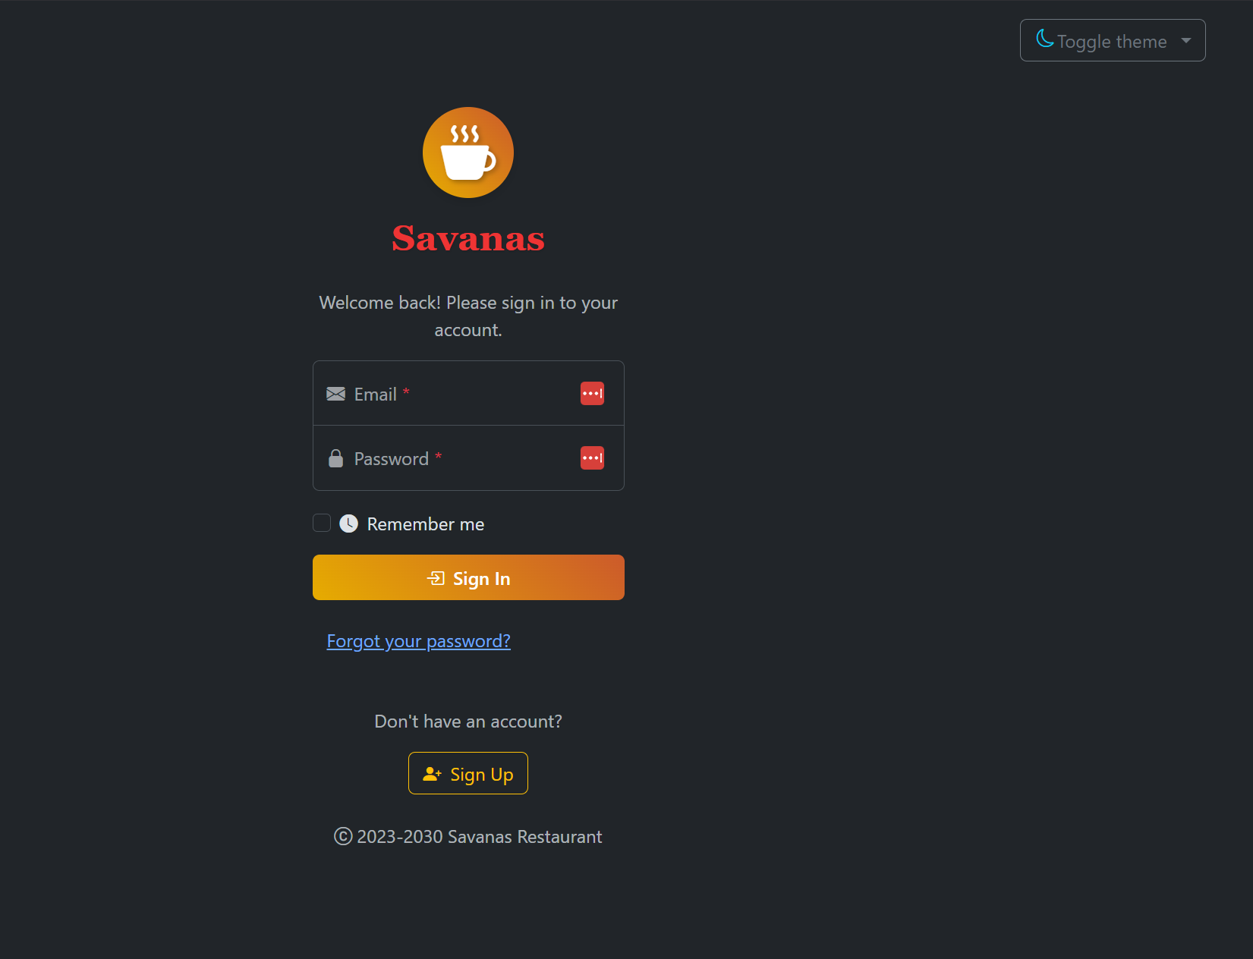
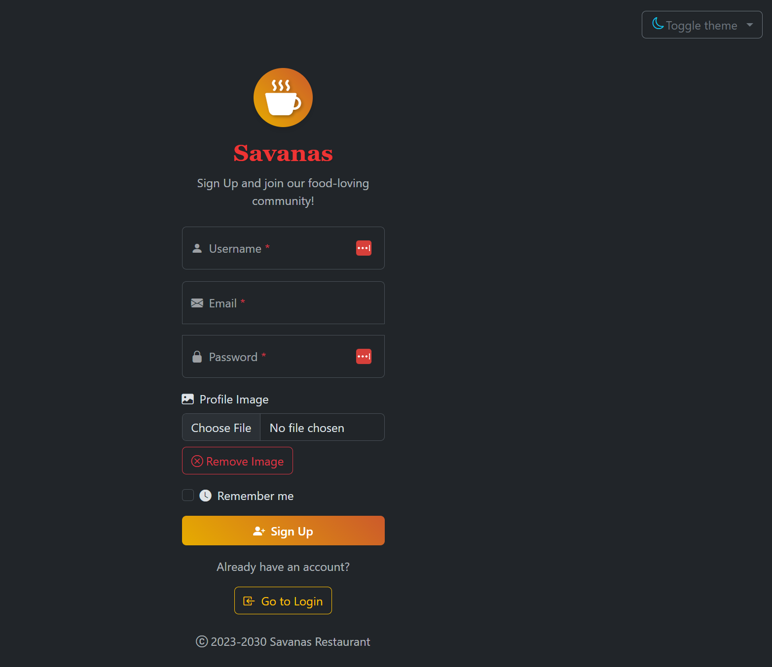
Login/registration system
Remember me with cookies
Forgot my password
- Sends email via Google’s SMTP (Simple Mail Transfer Protocol)
- Stores OTP (One Time Password) in the database and when it is time it deletes it.

Slide 4
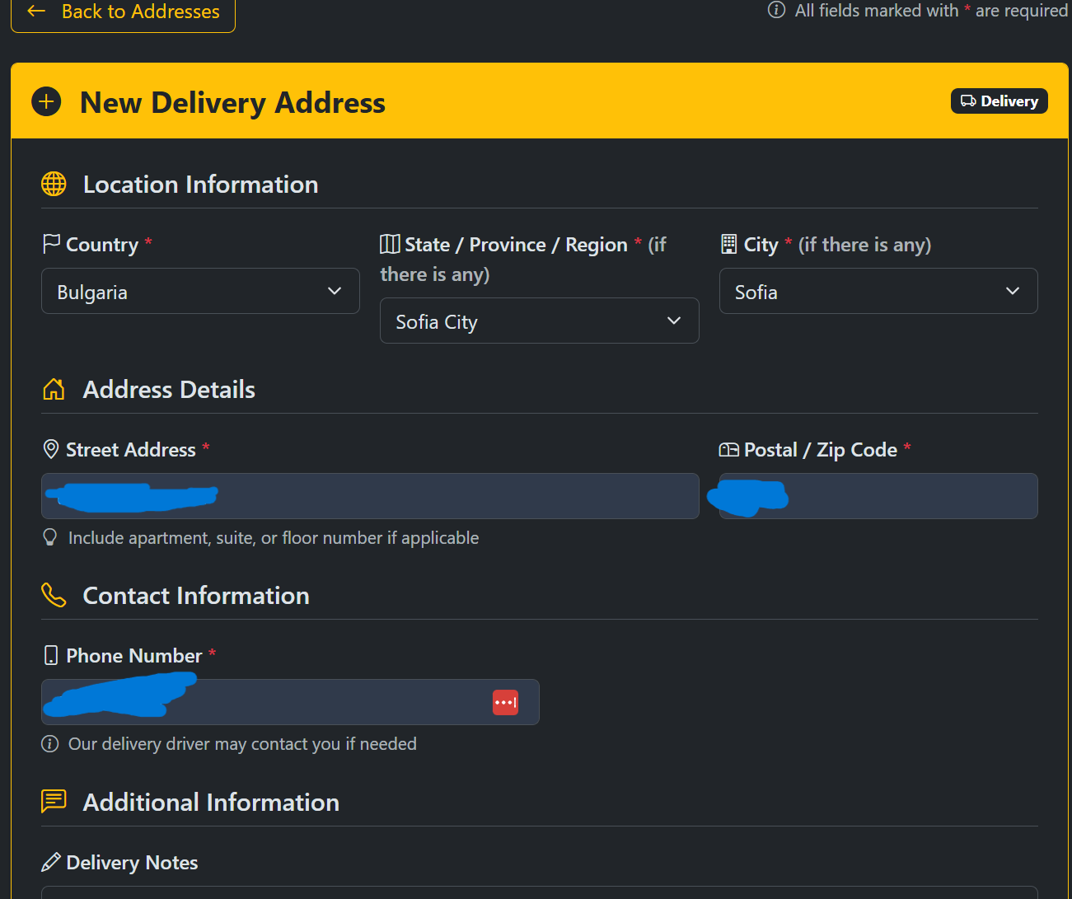
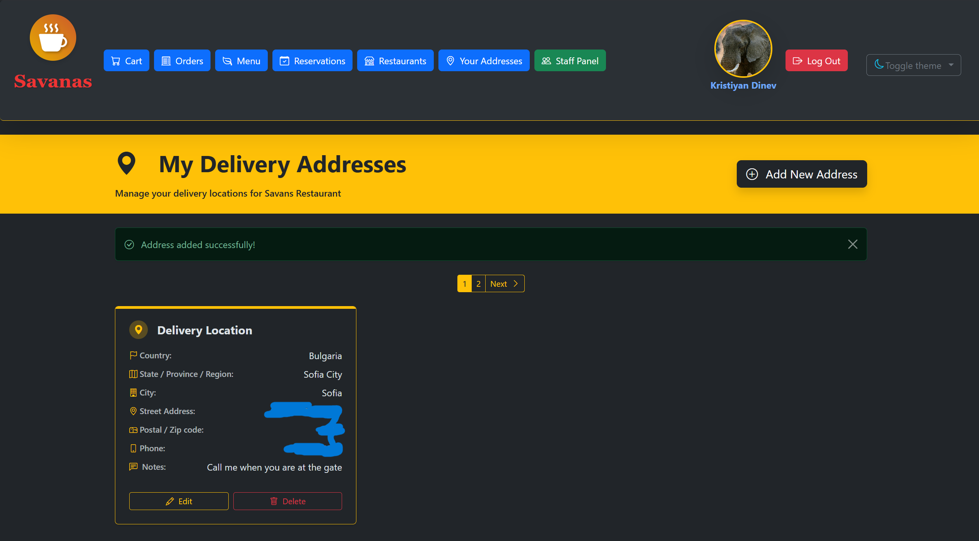
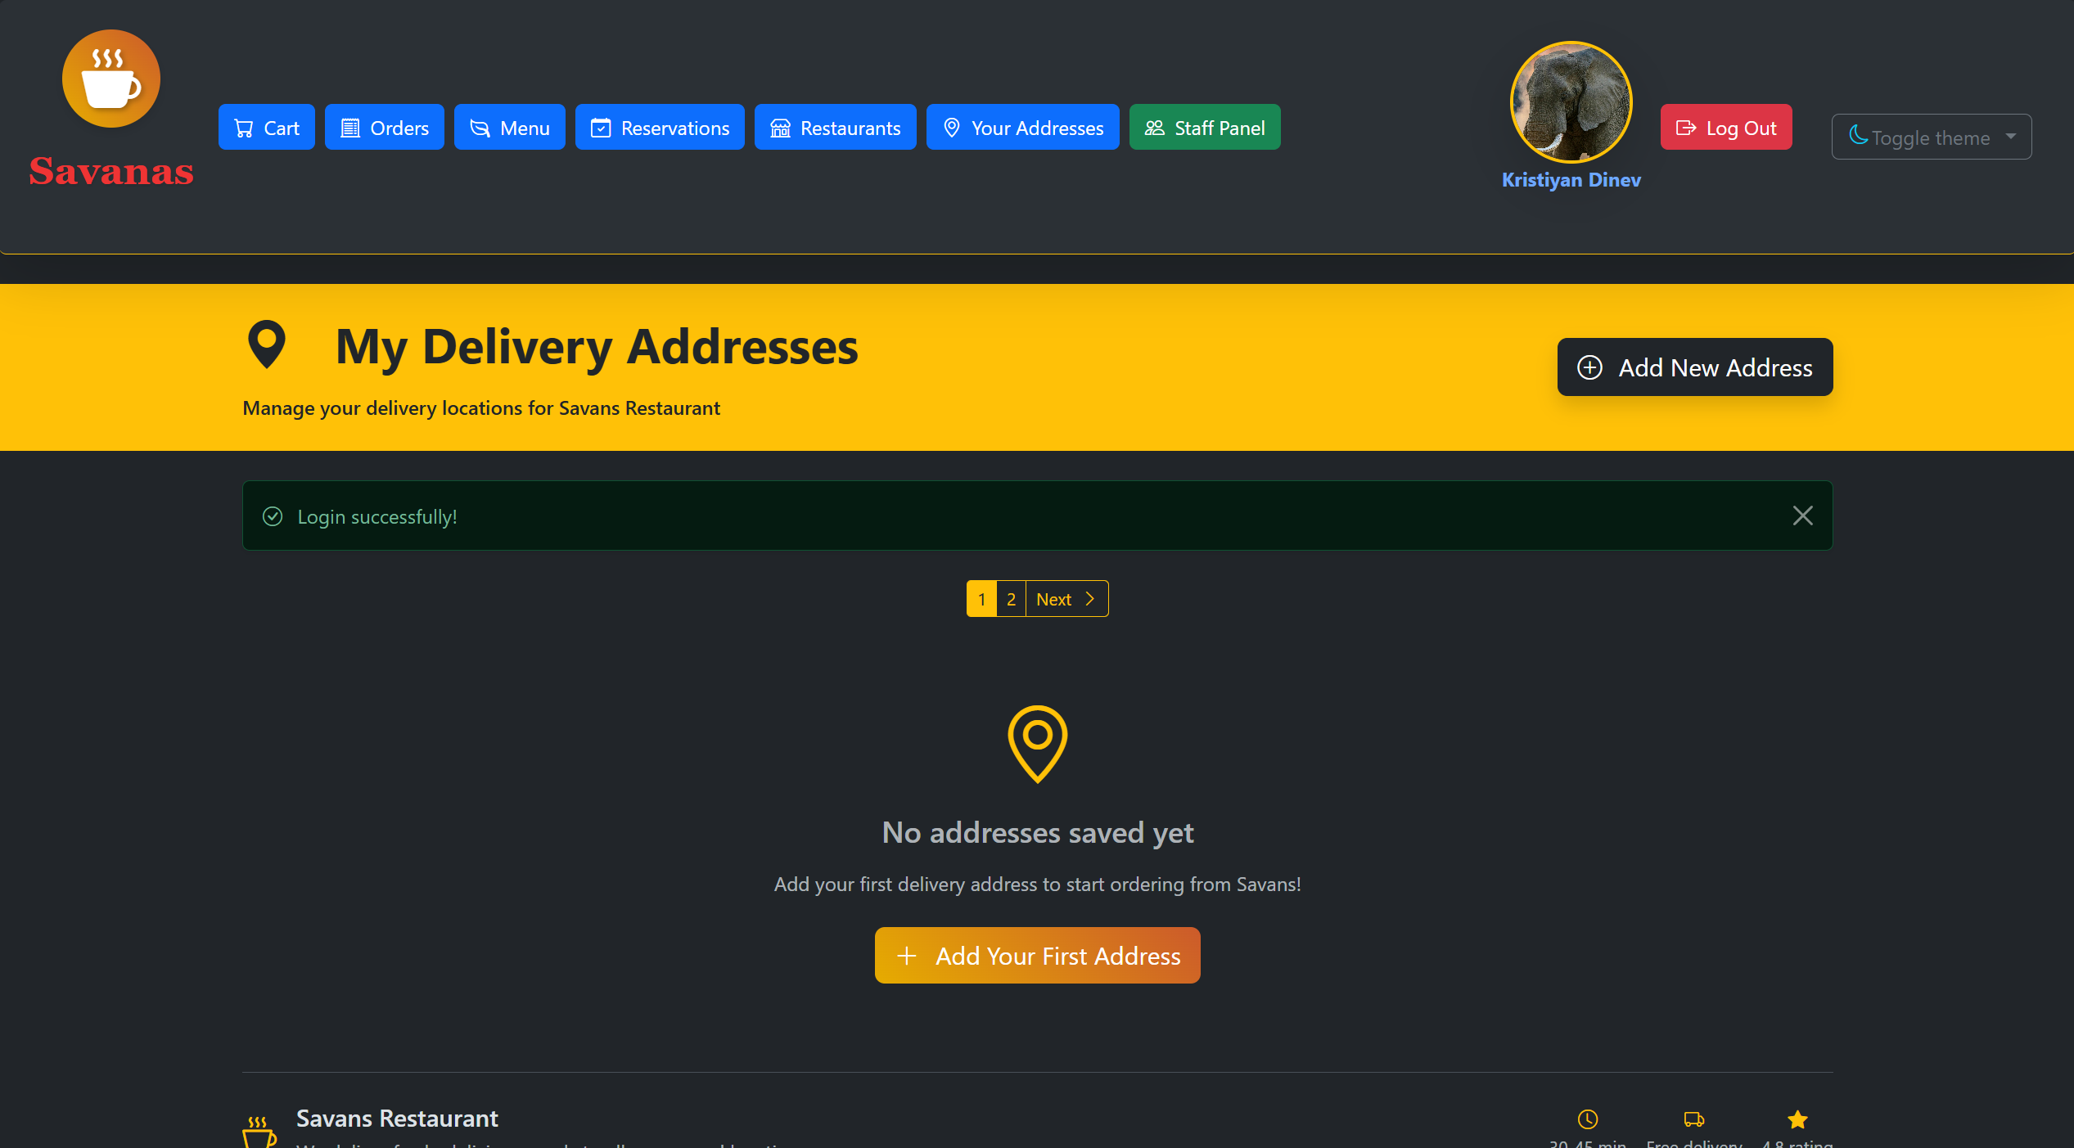
Delivery addresses
Add as many addresses as you want
Order from anywhere with one account

Slide 5
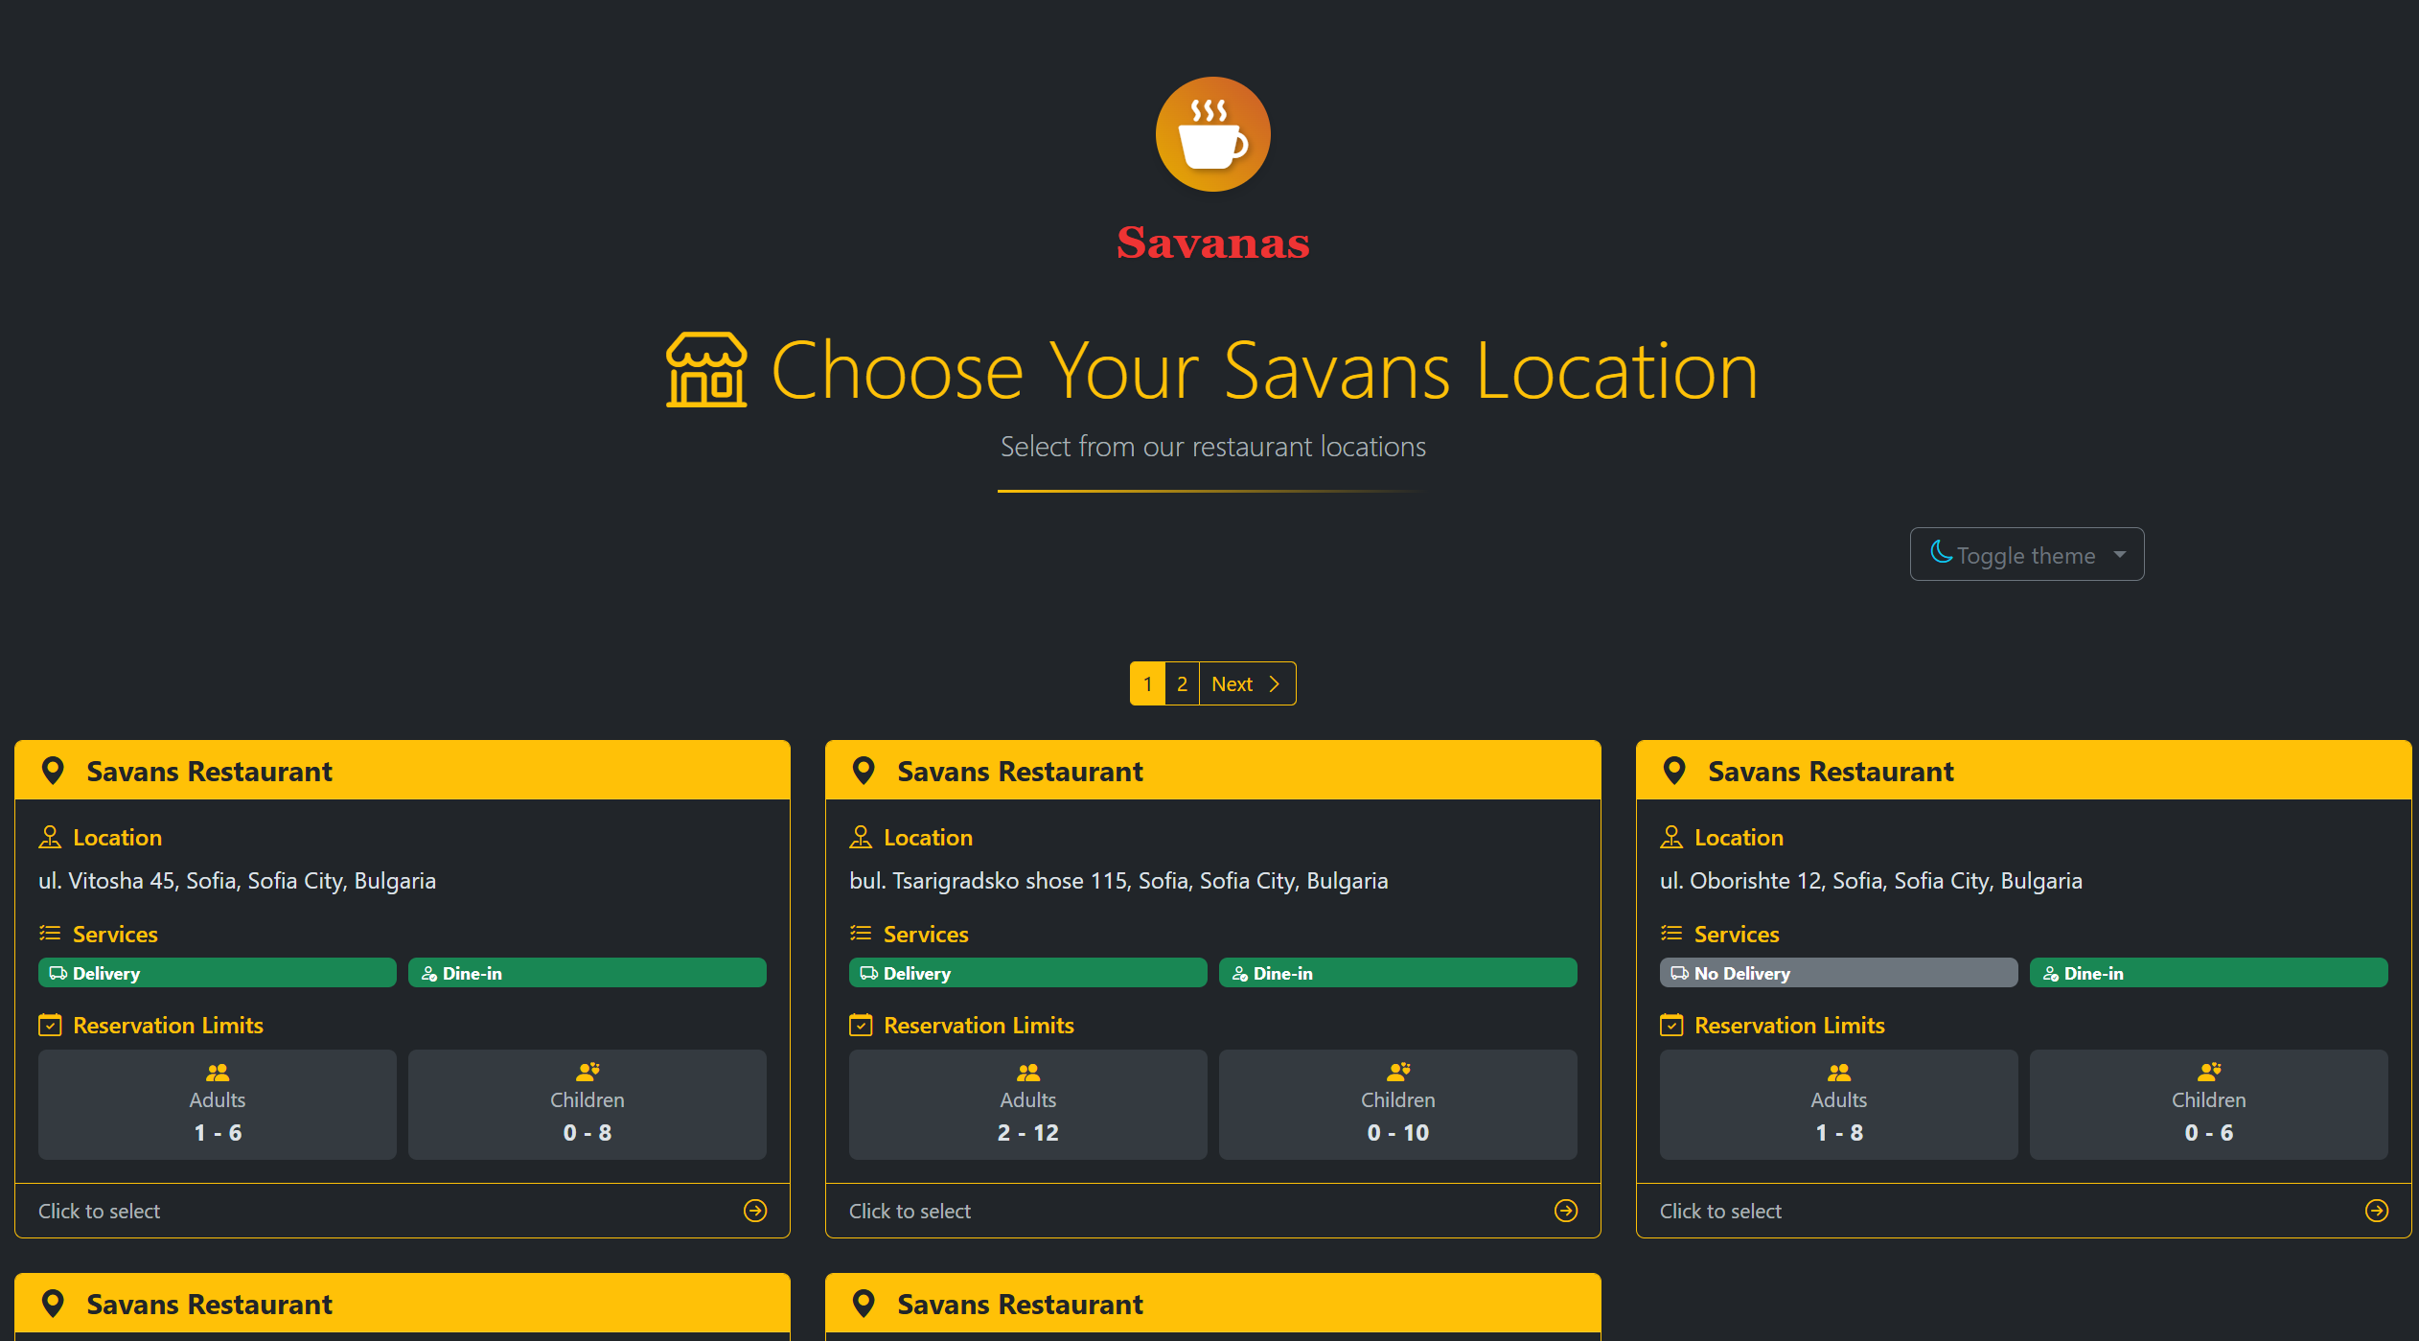
Select restaurant
Chose the restaurants which can serve you
Details about every restaurant

Slide 6
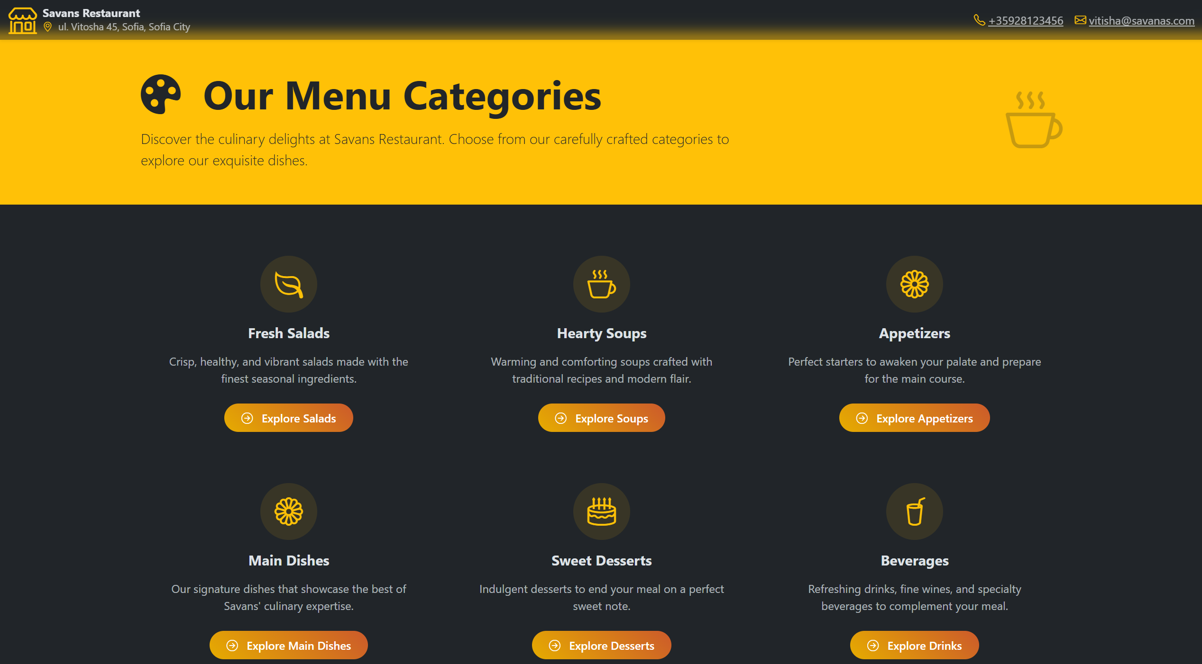
Select your food
Many choices
All you need to know about the food you are ordering

Slide 7
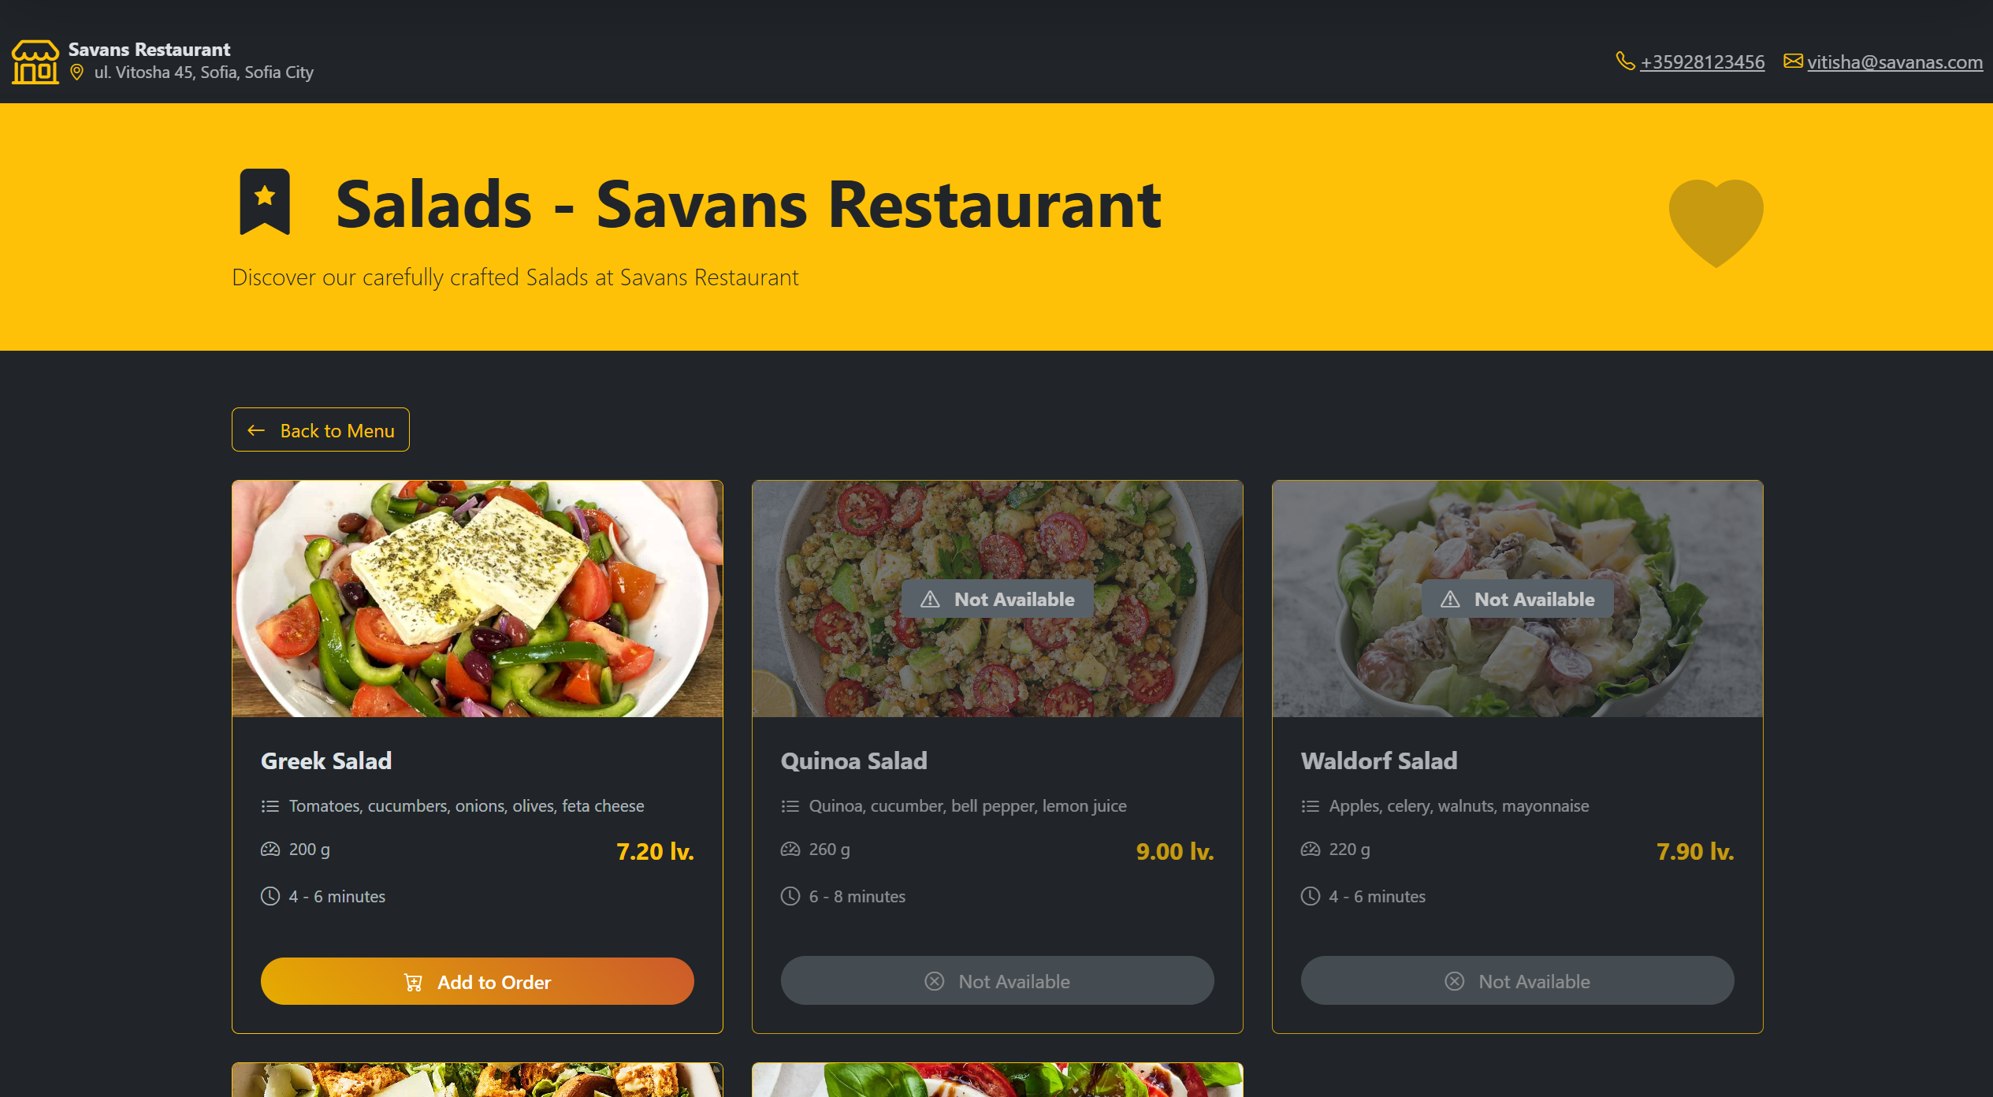
Salads

Slide 8
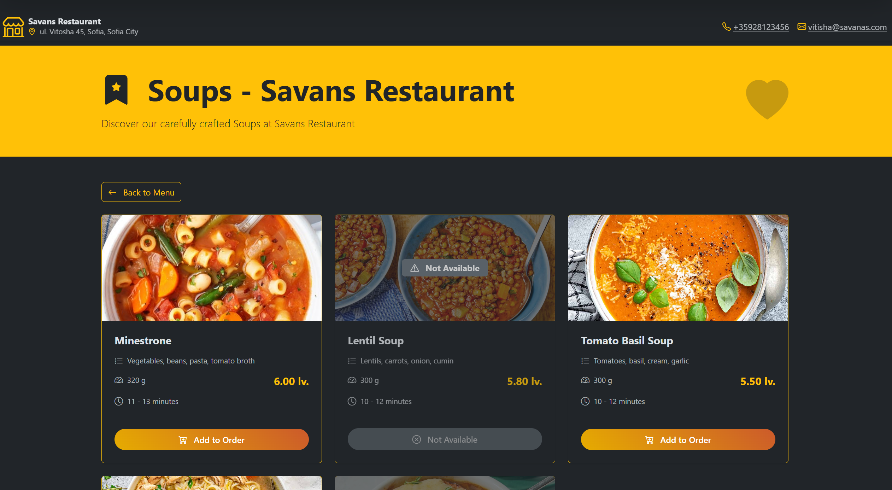
Soups

Slide 9
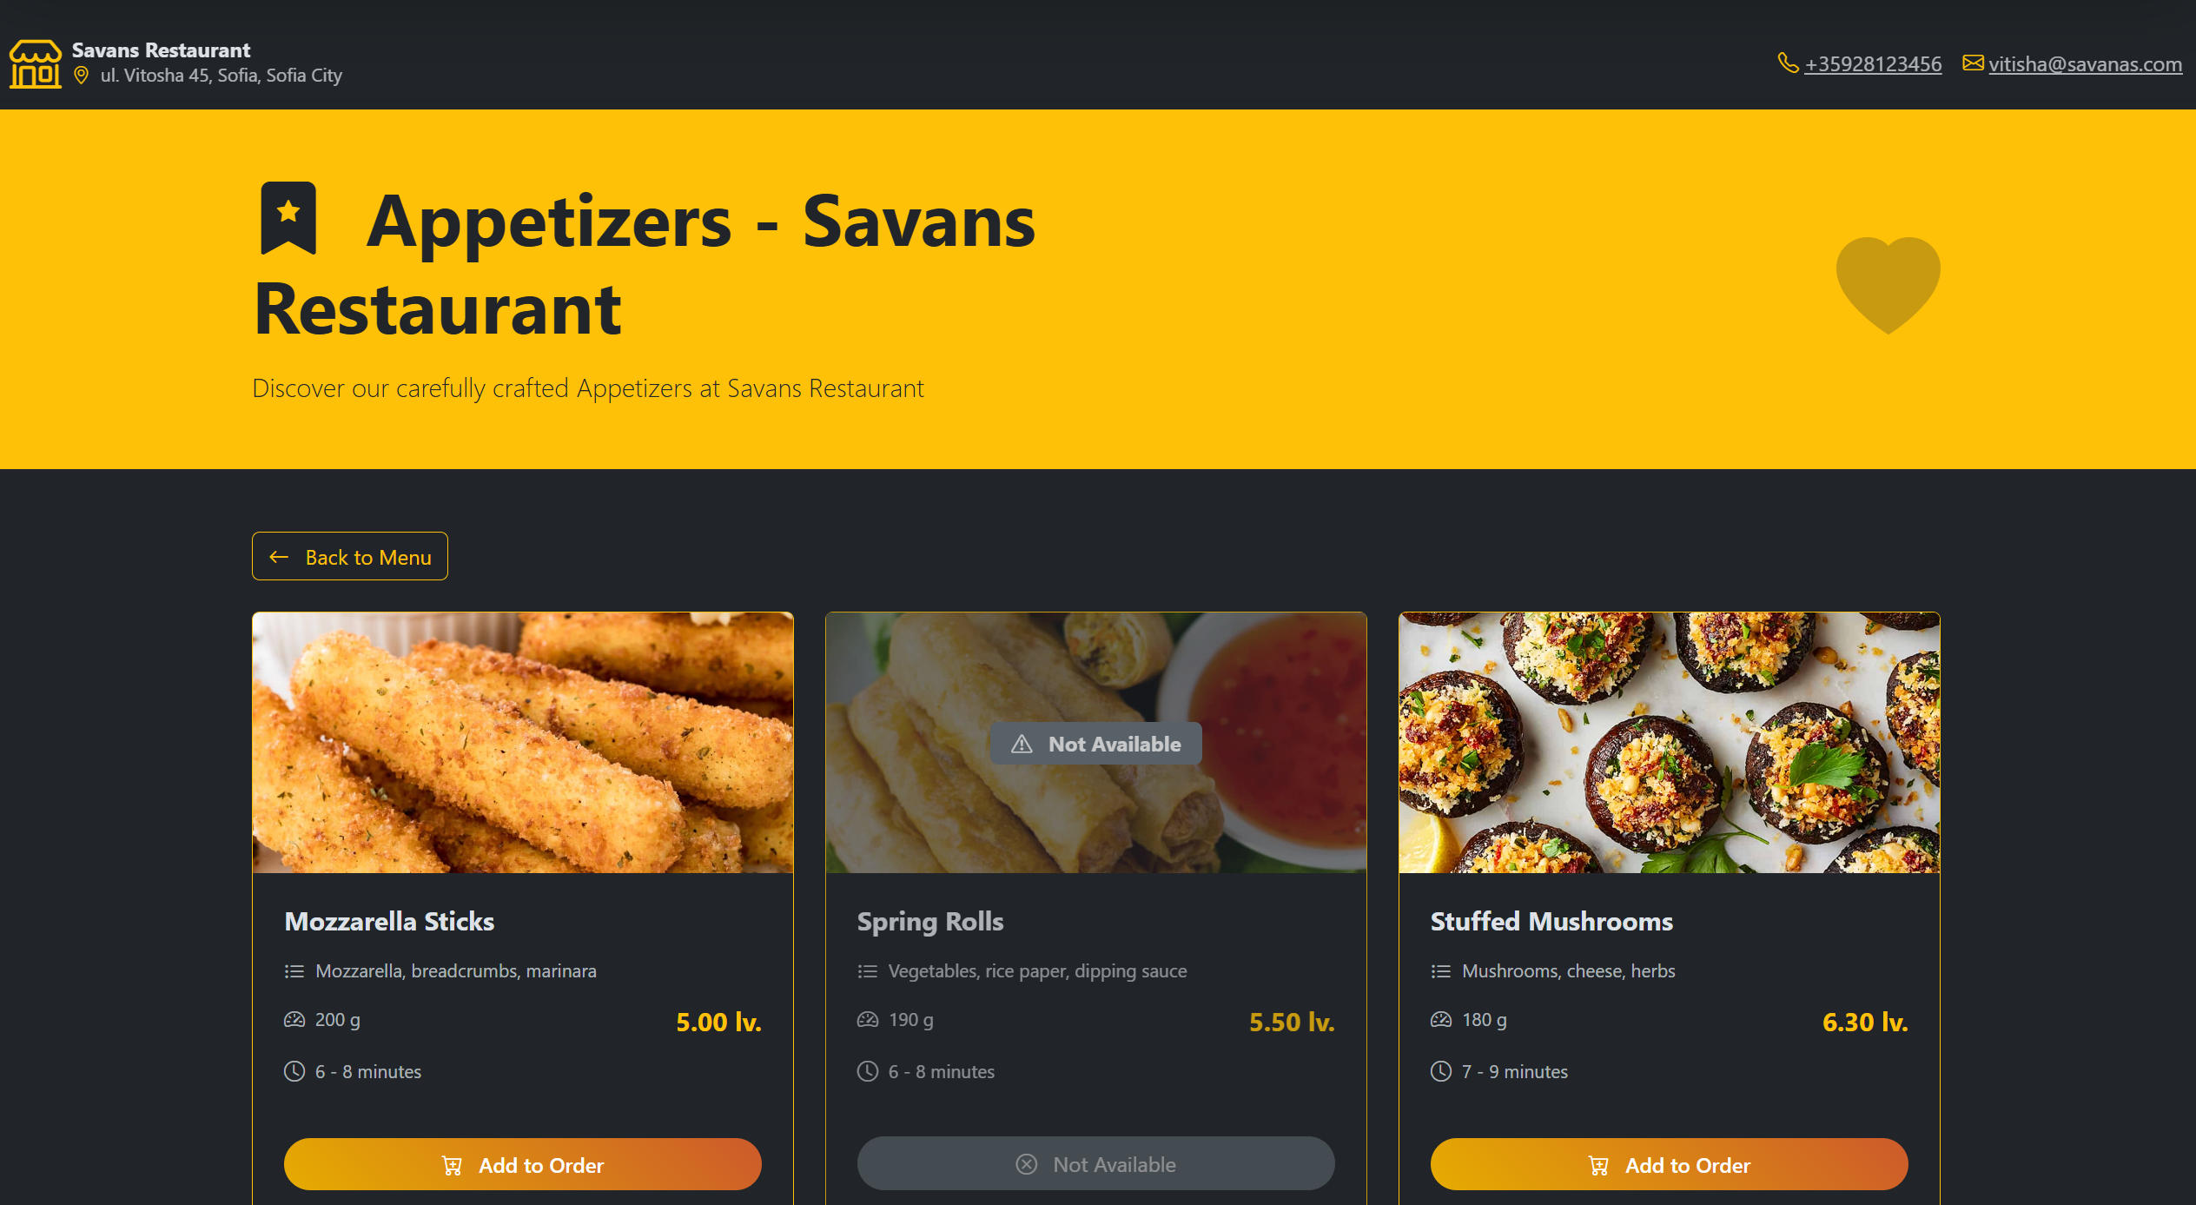
Appetizers

Slide 10
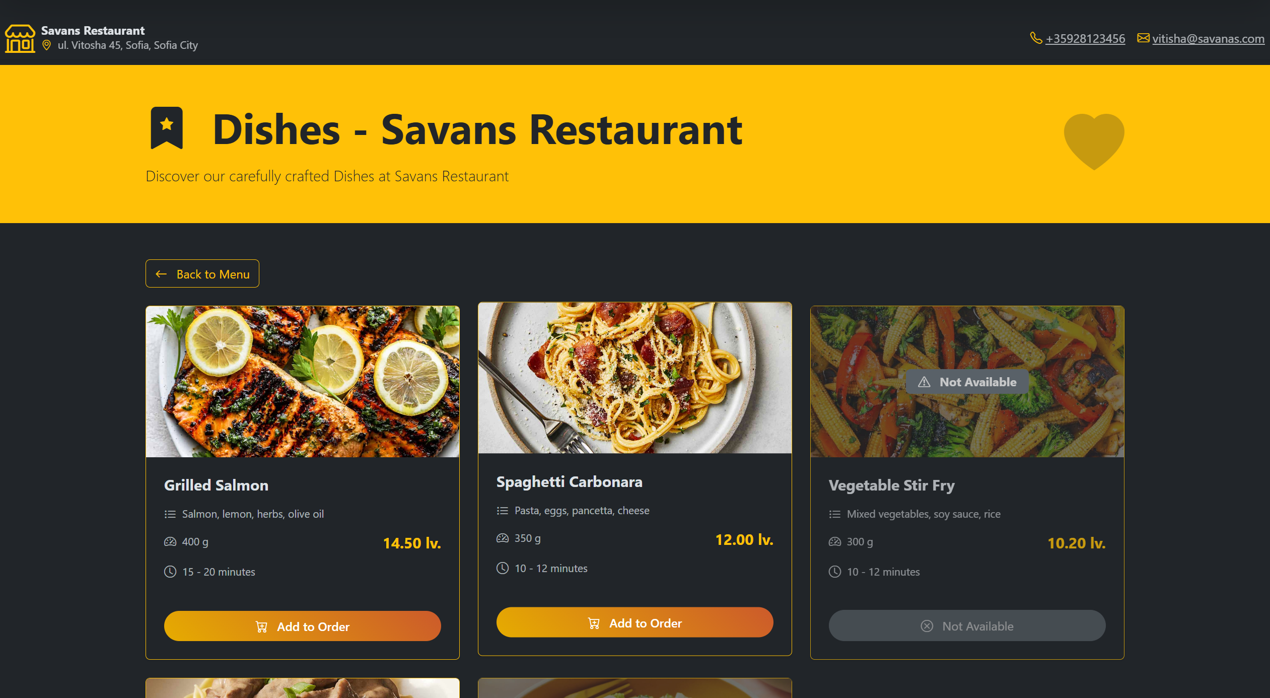
Main Dishes

Slide 11
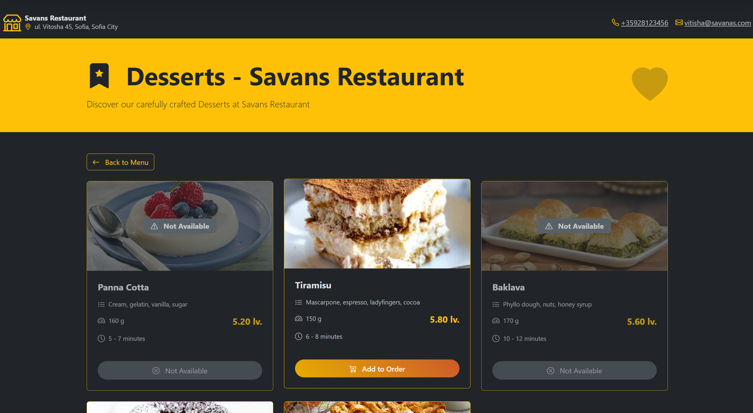
Desserts

Slide 12
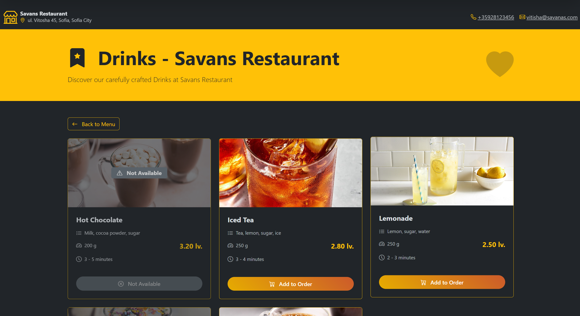
Drinks

Slide 13
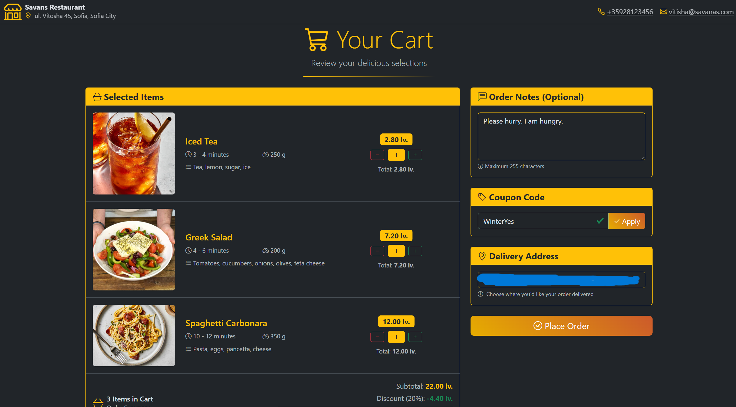
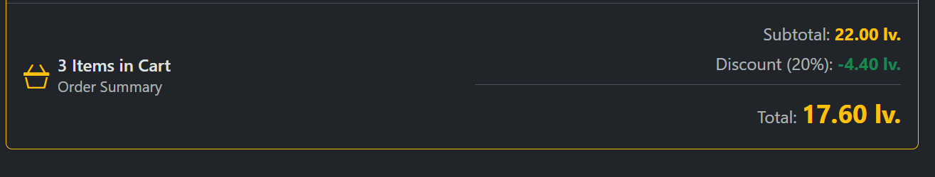
Your cart
Apply coupons and save money
Place your order in seconds

Slide 14
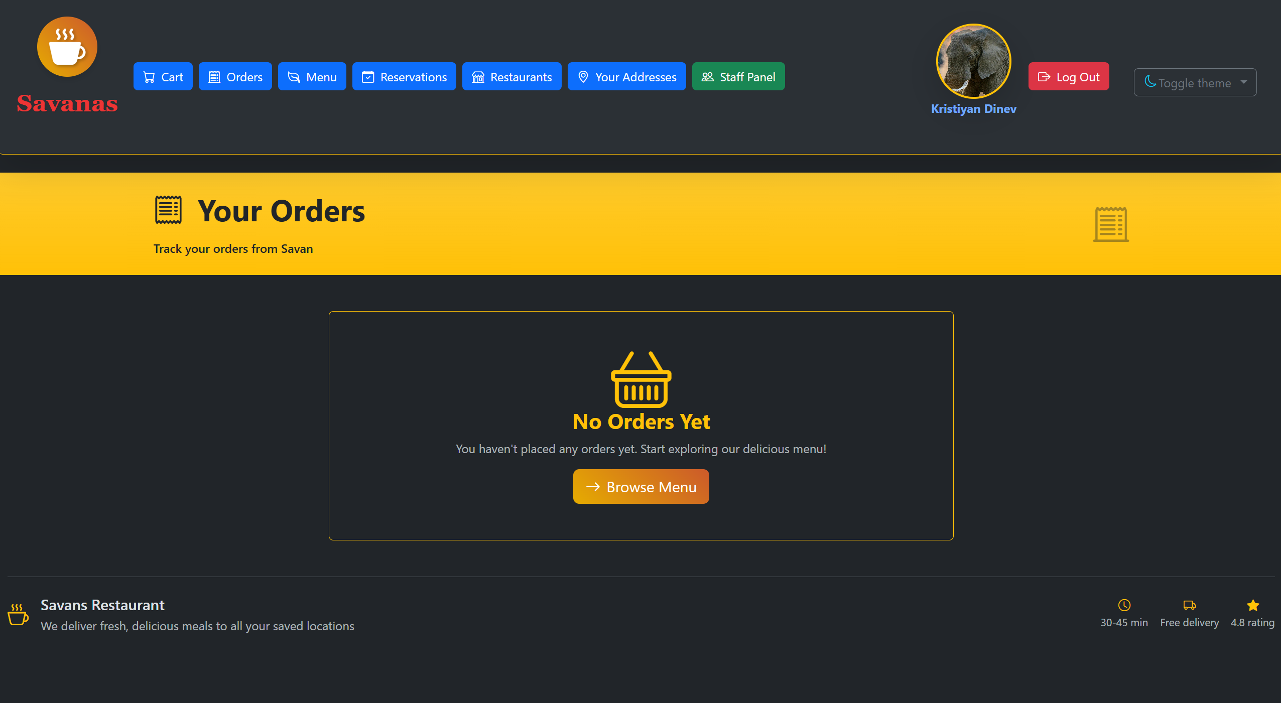
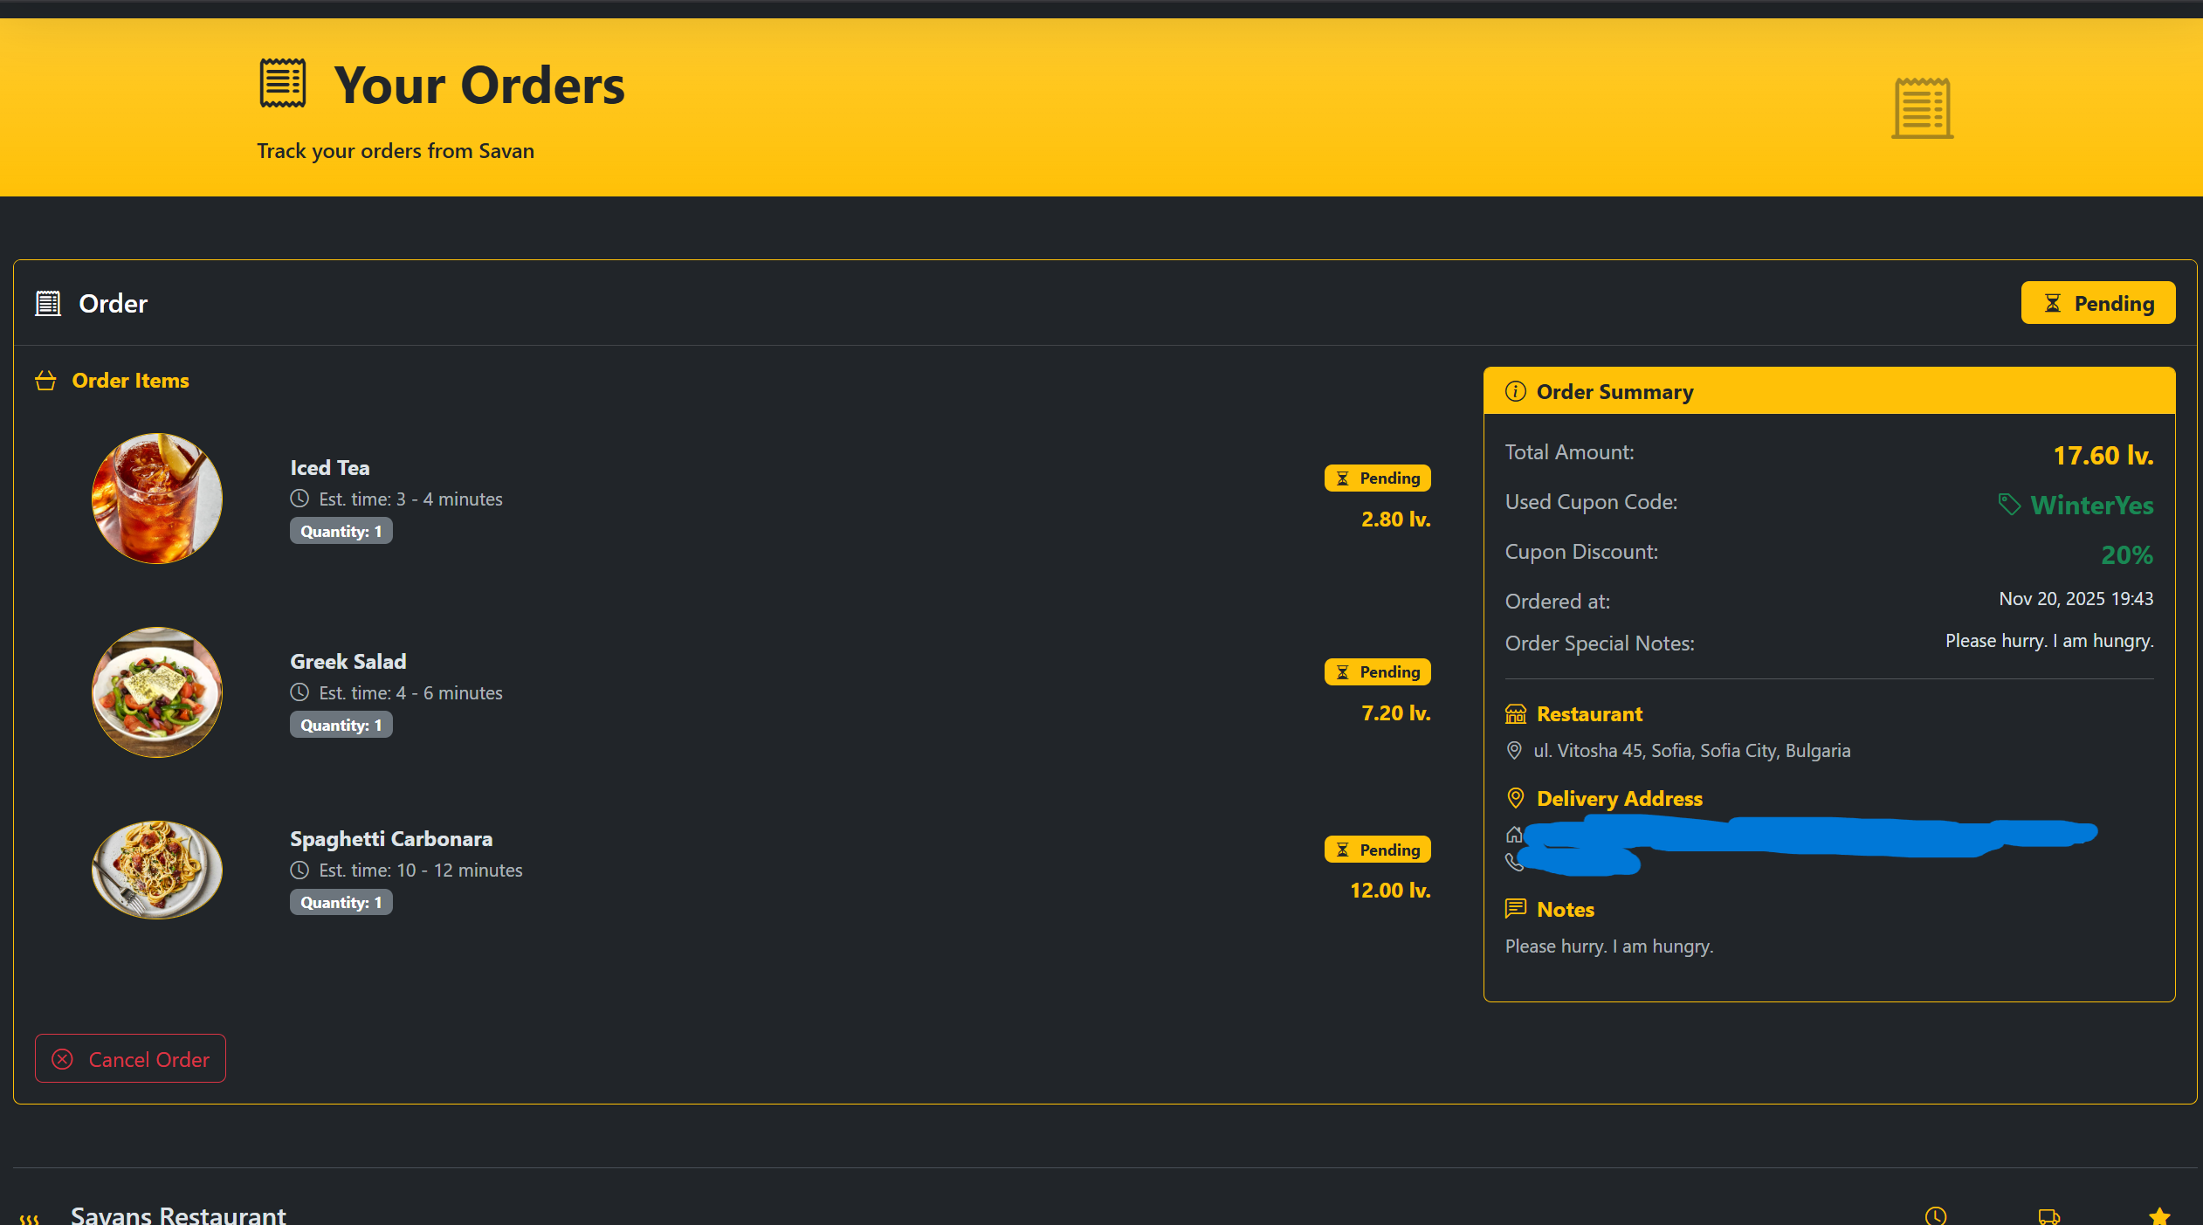
Your orders
Track your orders in real time

Slide 15
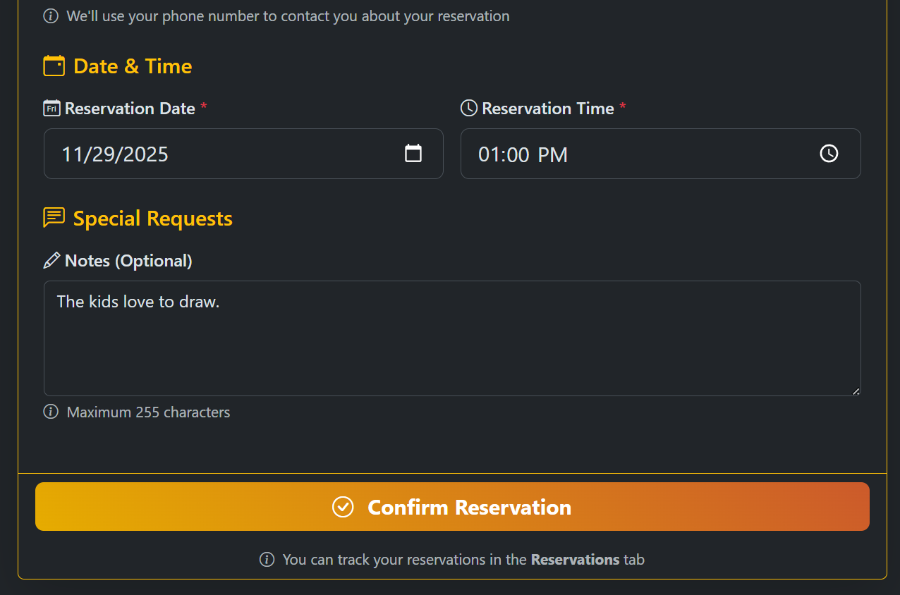
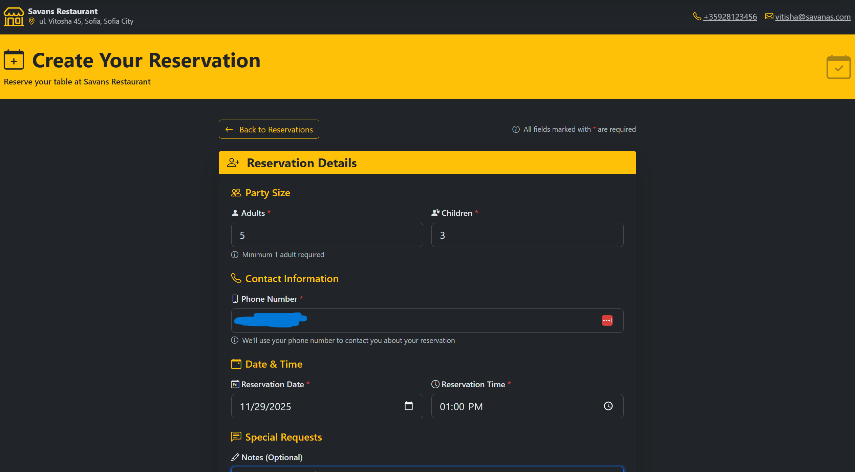
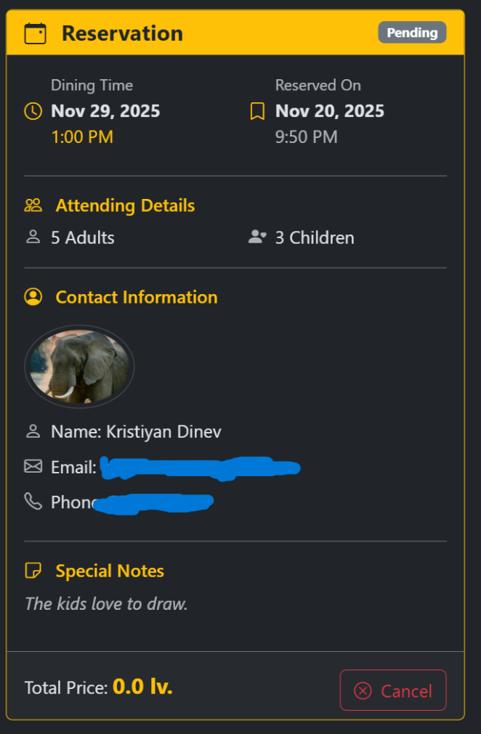
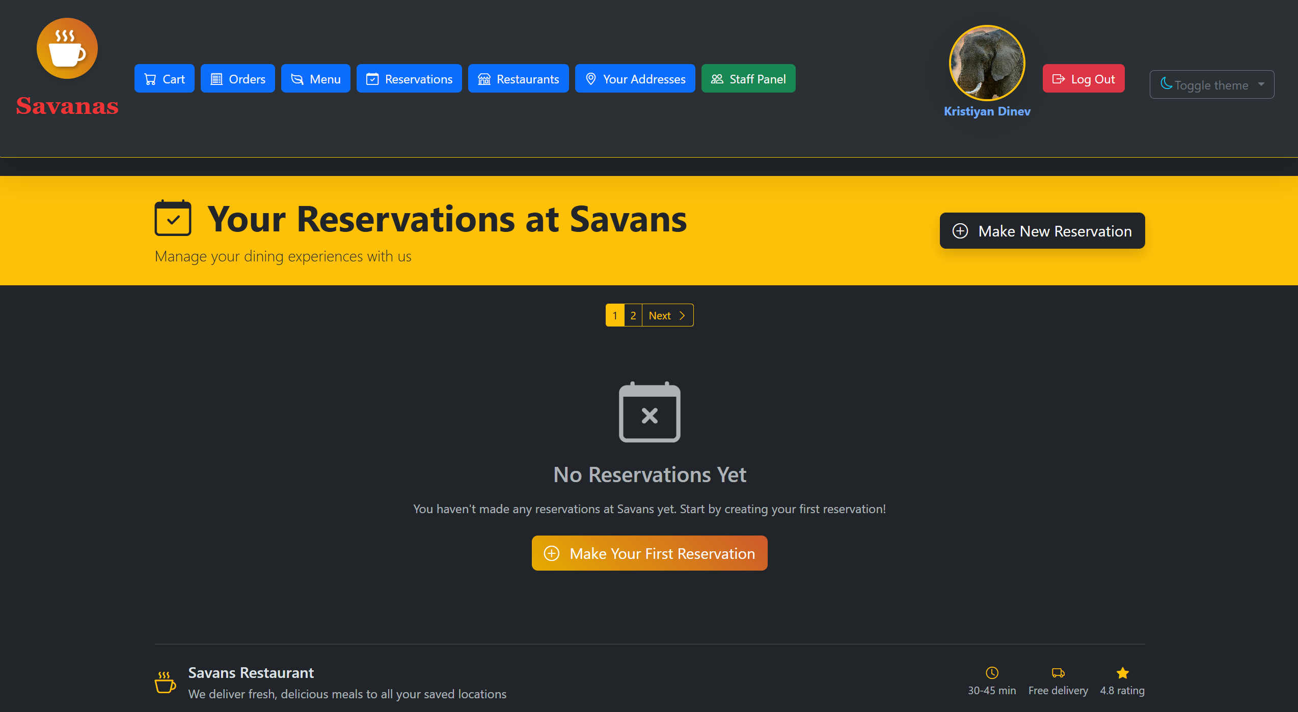
reservations
Get your table and spend some time together with family or friends

Slide 16
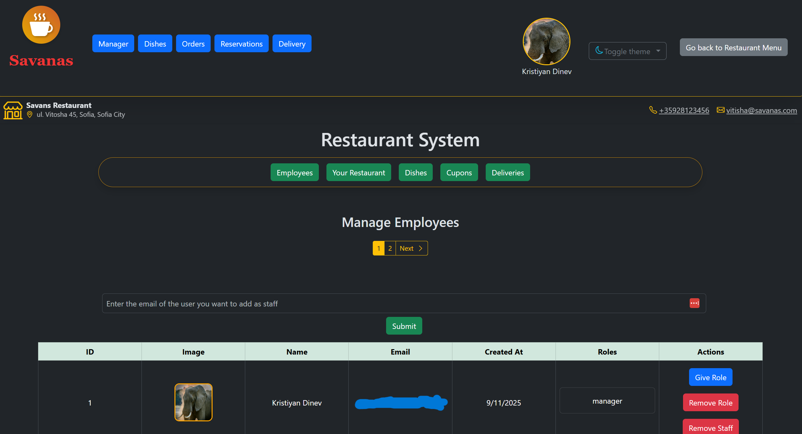
Admin panel
Keep track of your employes
Only available for staff with role Manager
Only the Manager can add other staff and give them roles
Only the Manager has access to all admin features

Slide 17
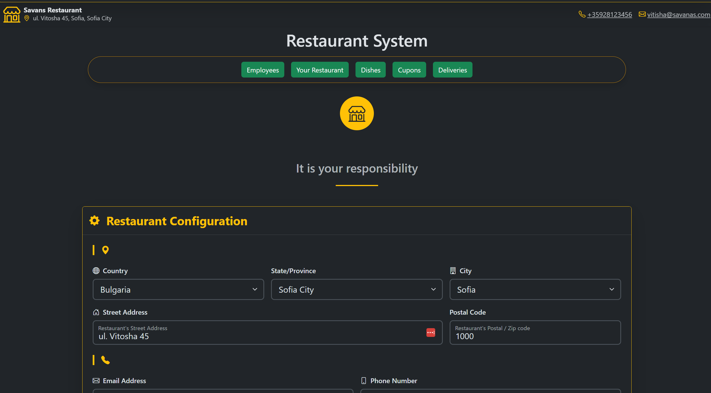
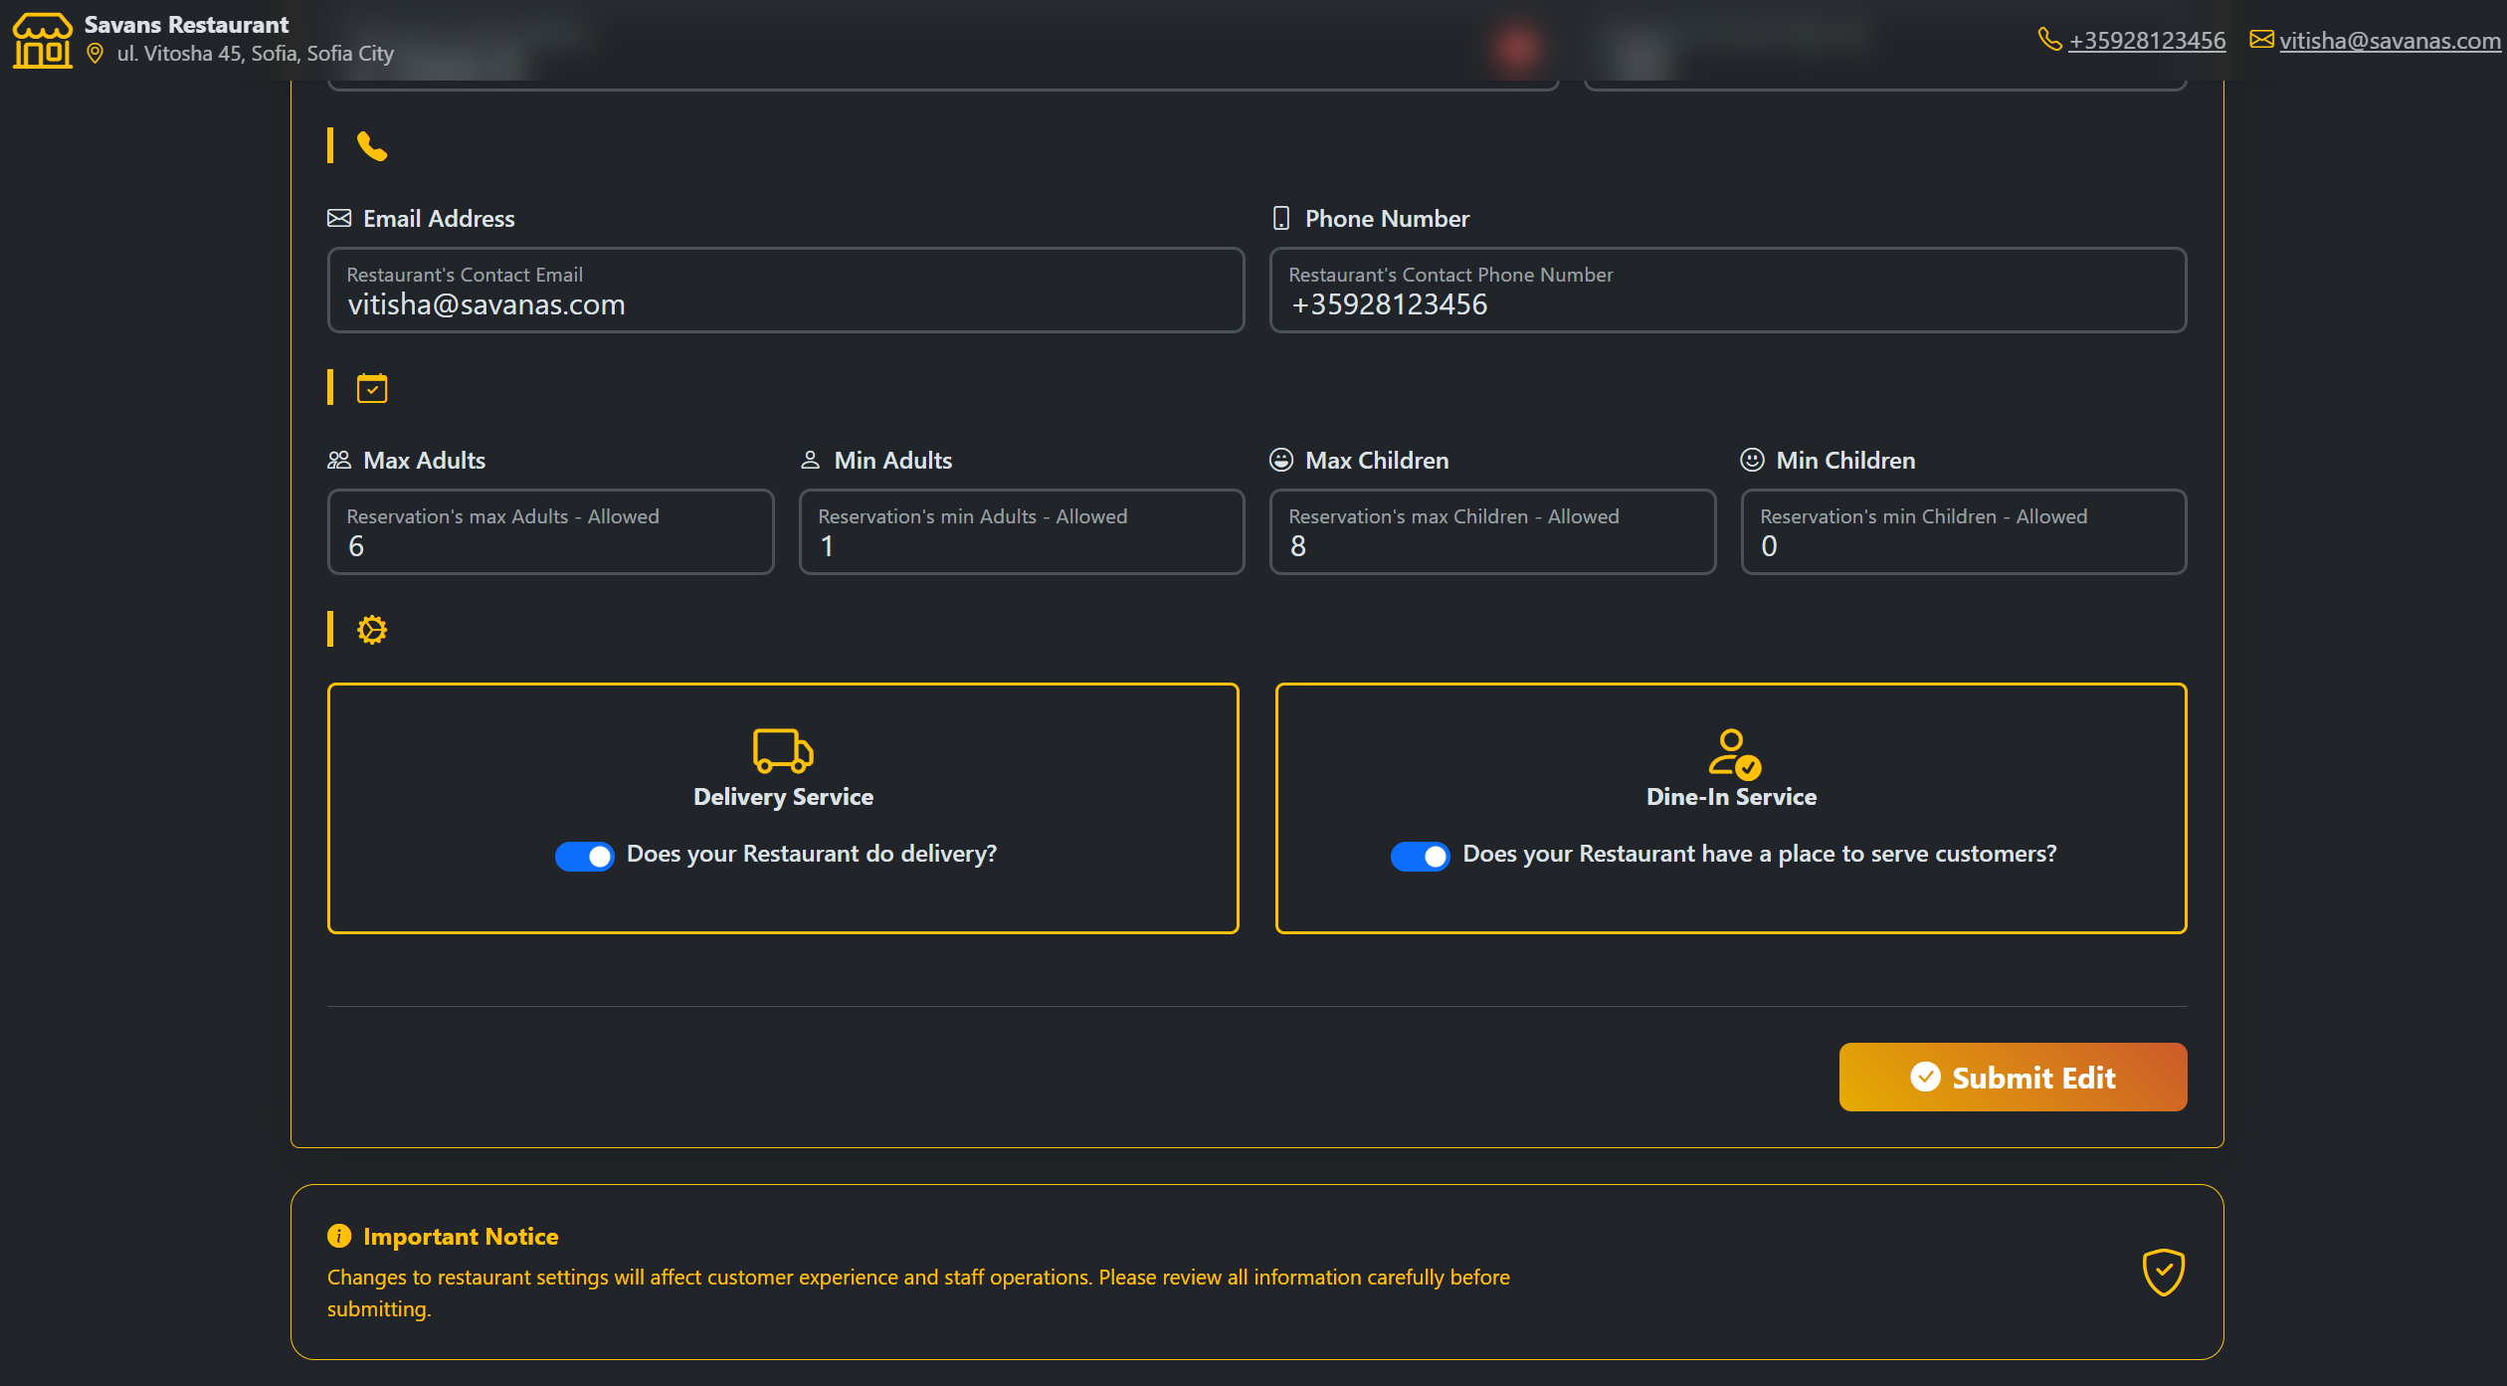
Admin panel – restaurant view
View and Update how your customers see your restaurant on the website

Slide 18
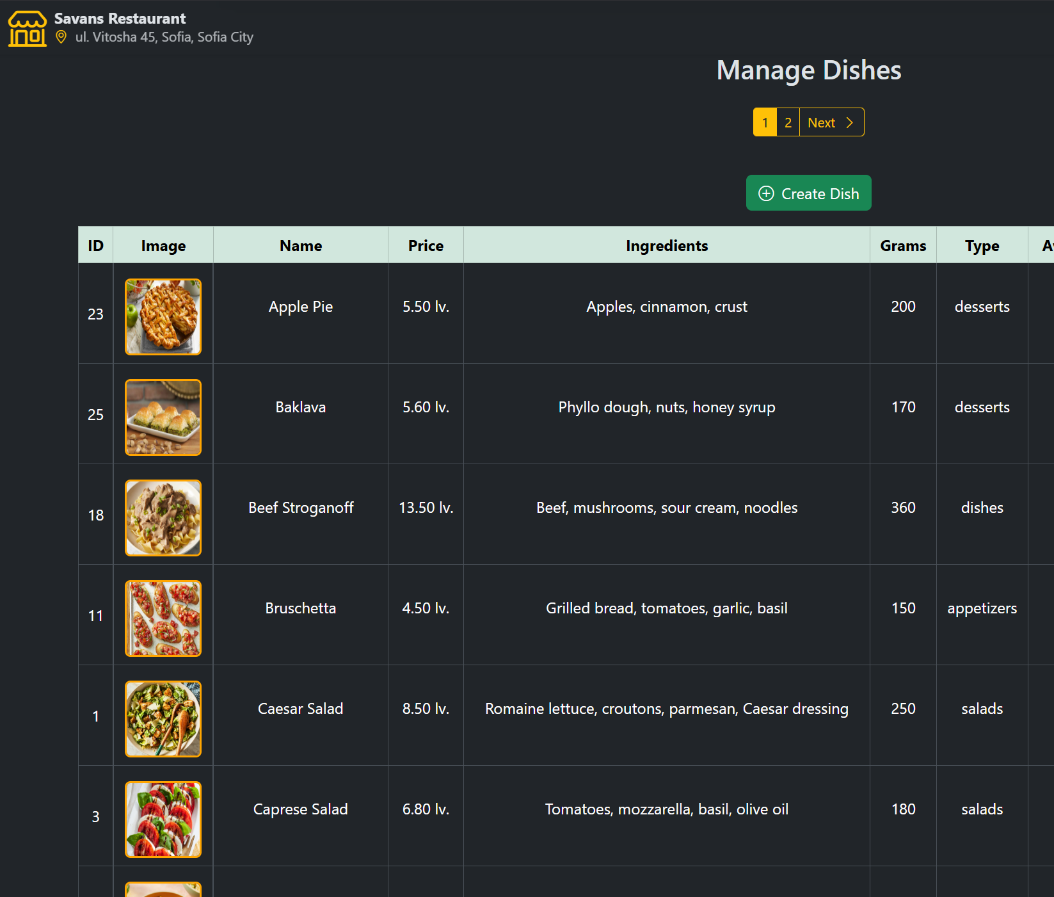
Admin panel - Dishes
Keep your dishes up to date
View, Add, Update and Remove any dish you like

Slide 19
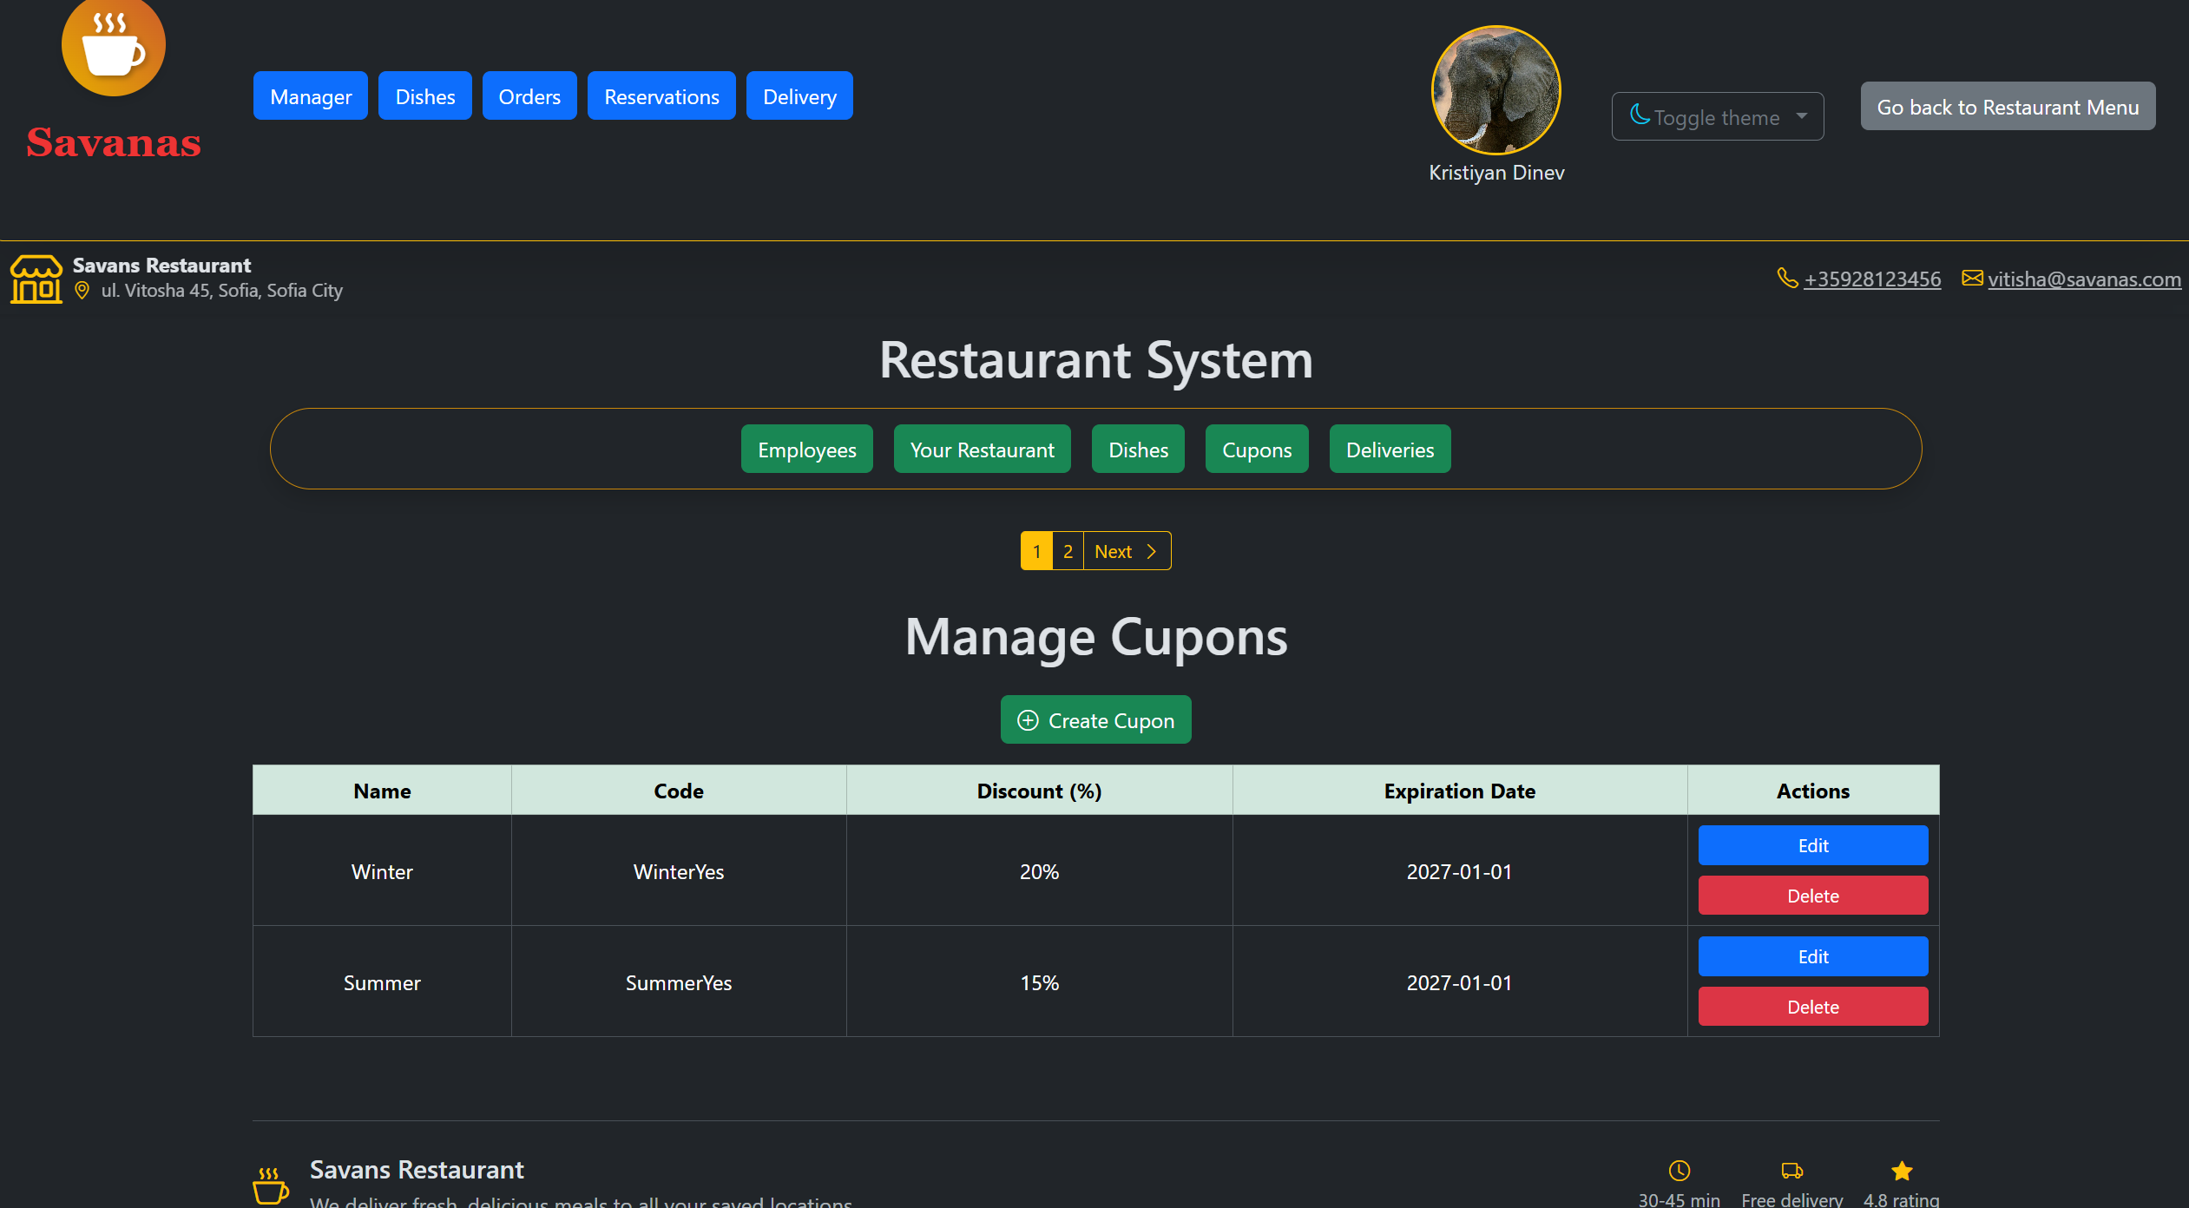
Admin panel - coupons
View, Add, Update and Remove any coupon codes you like
Keep your customers engaged

Slide 20
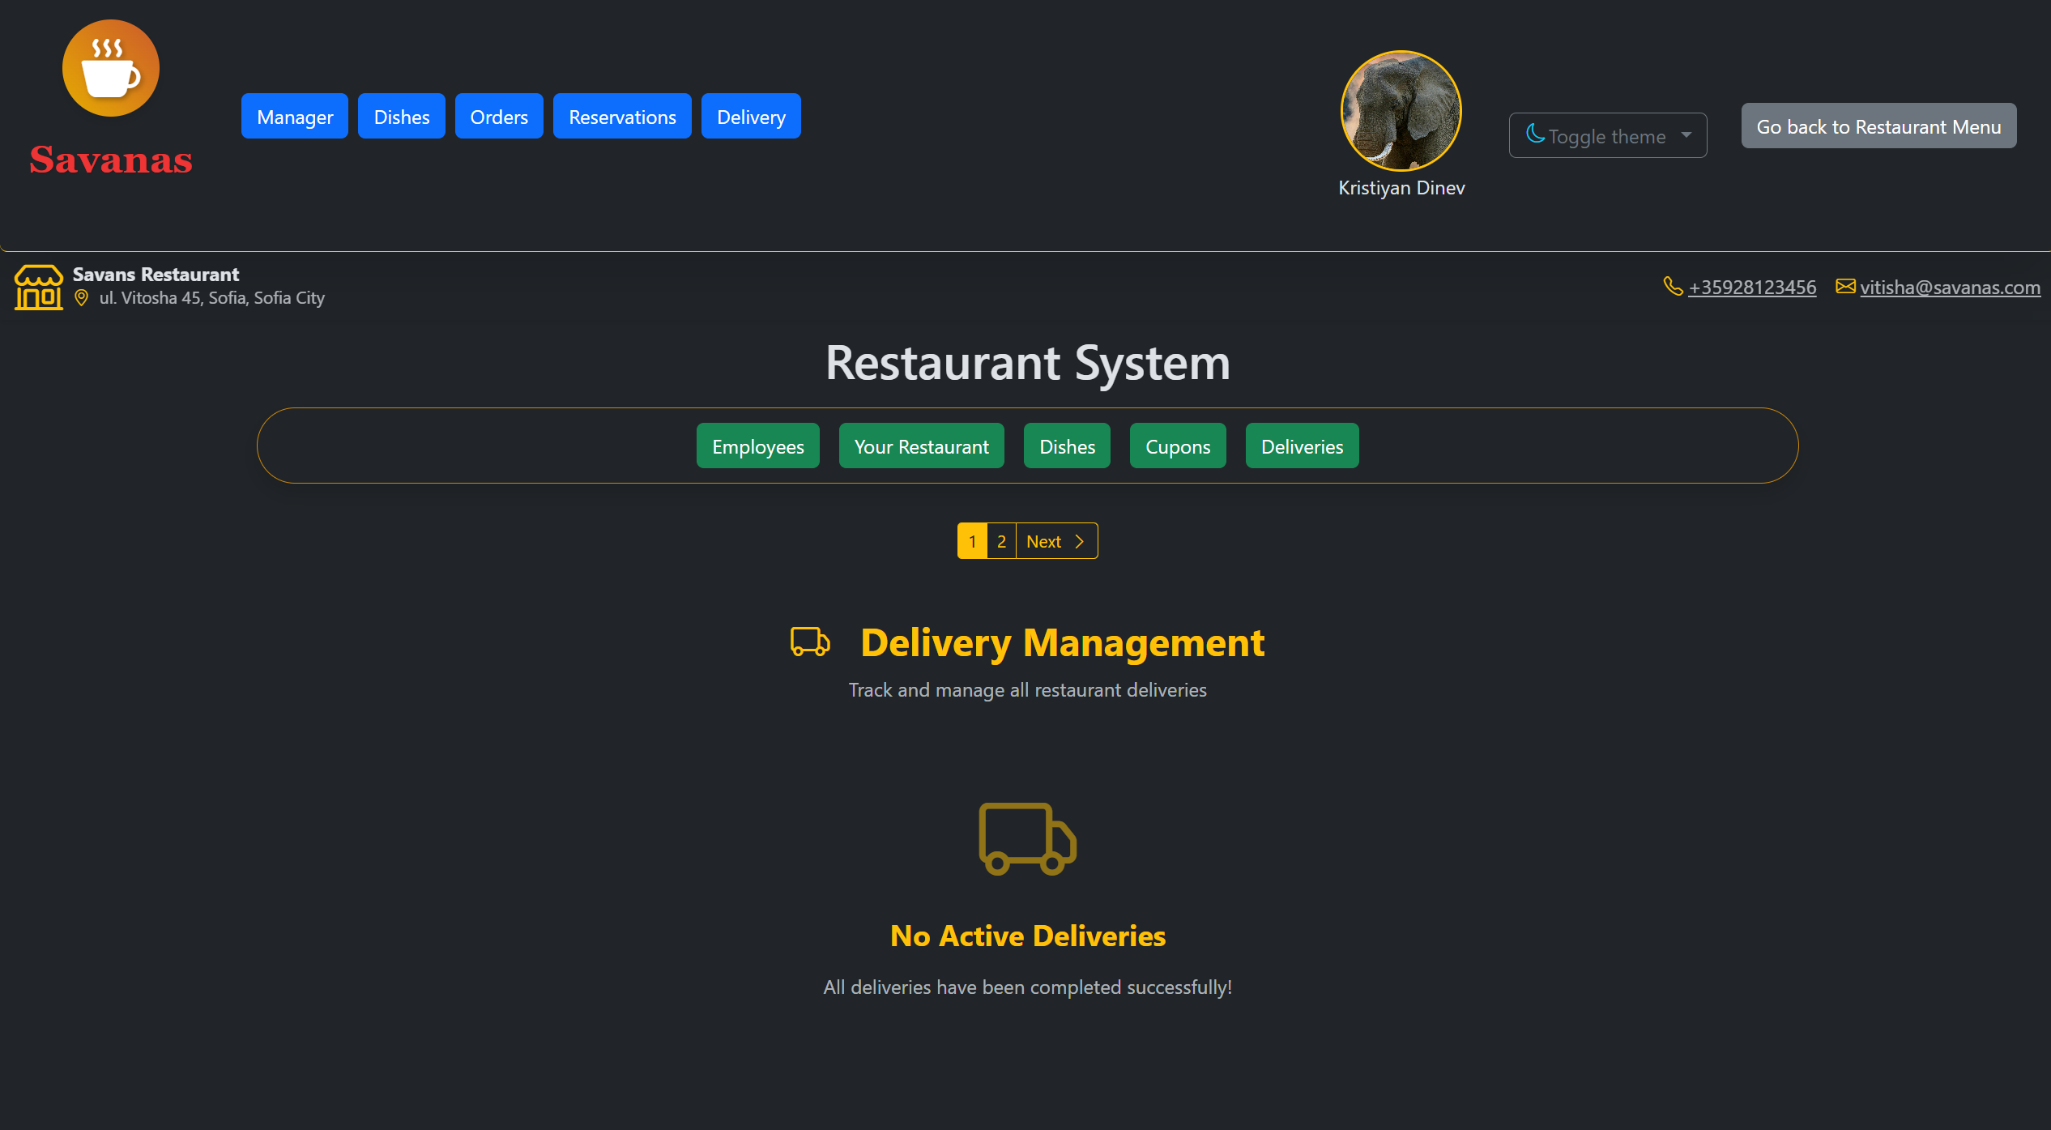
Admin panel – completed delivers
Track when online delivers are completed
Verify the delivers
Simple working delivery system

Slide 21
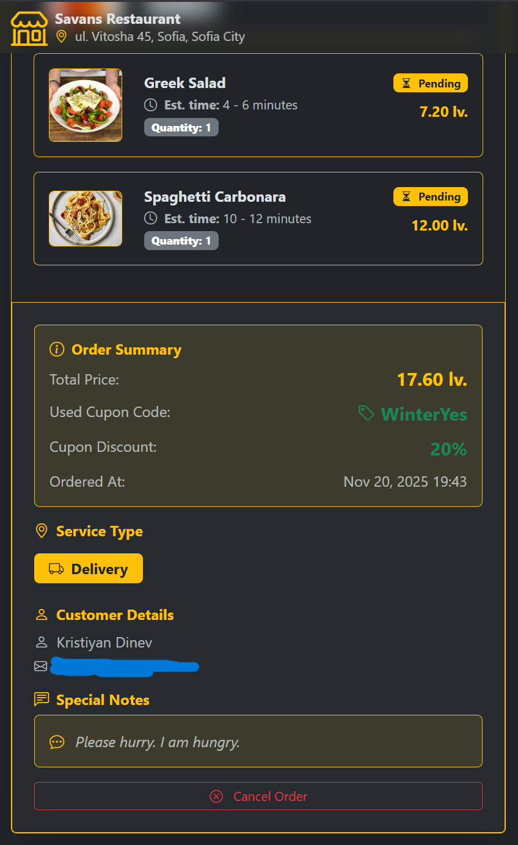
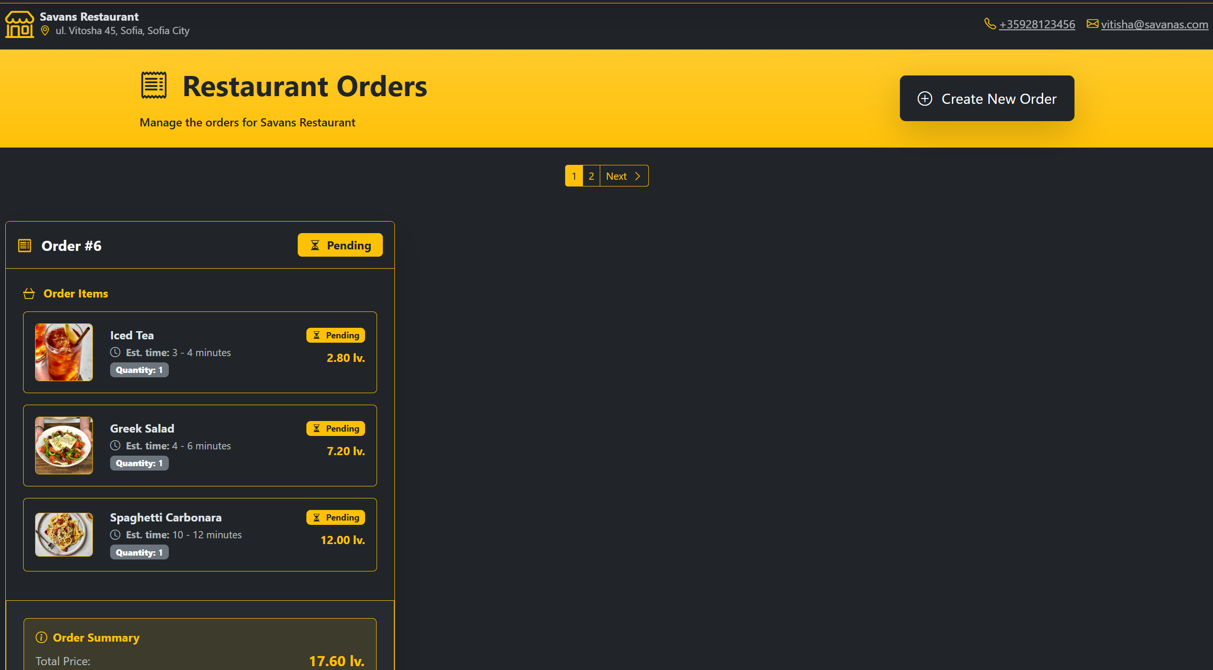
Admin panel - orders
Manage all the orders which are happening at the restaurant. Both deliveries and dinning.
Only available for staff with role Waiter/Waitress.

Slide 22
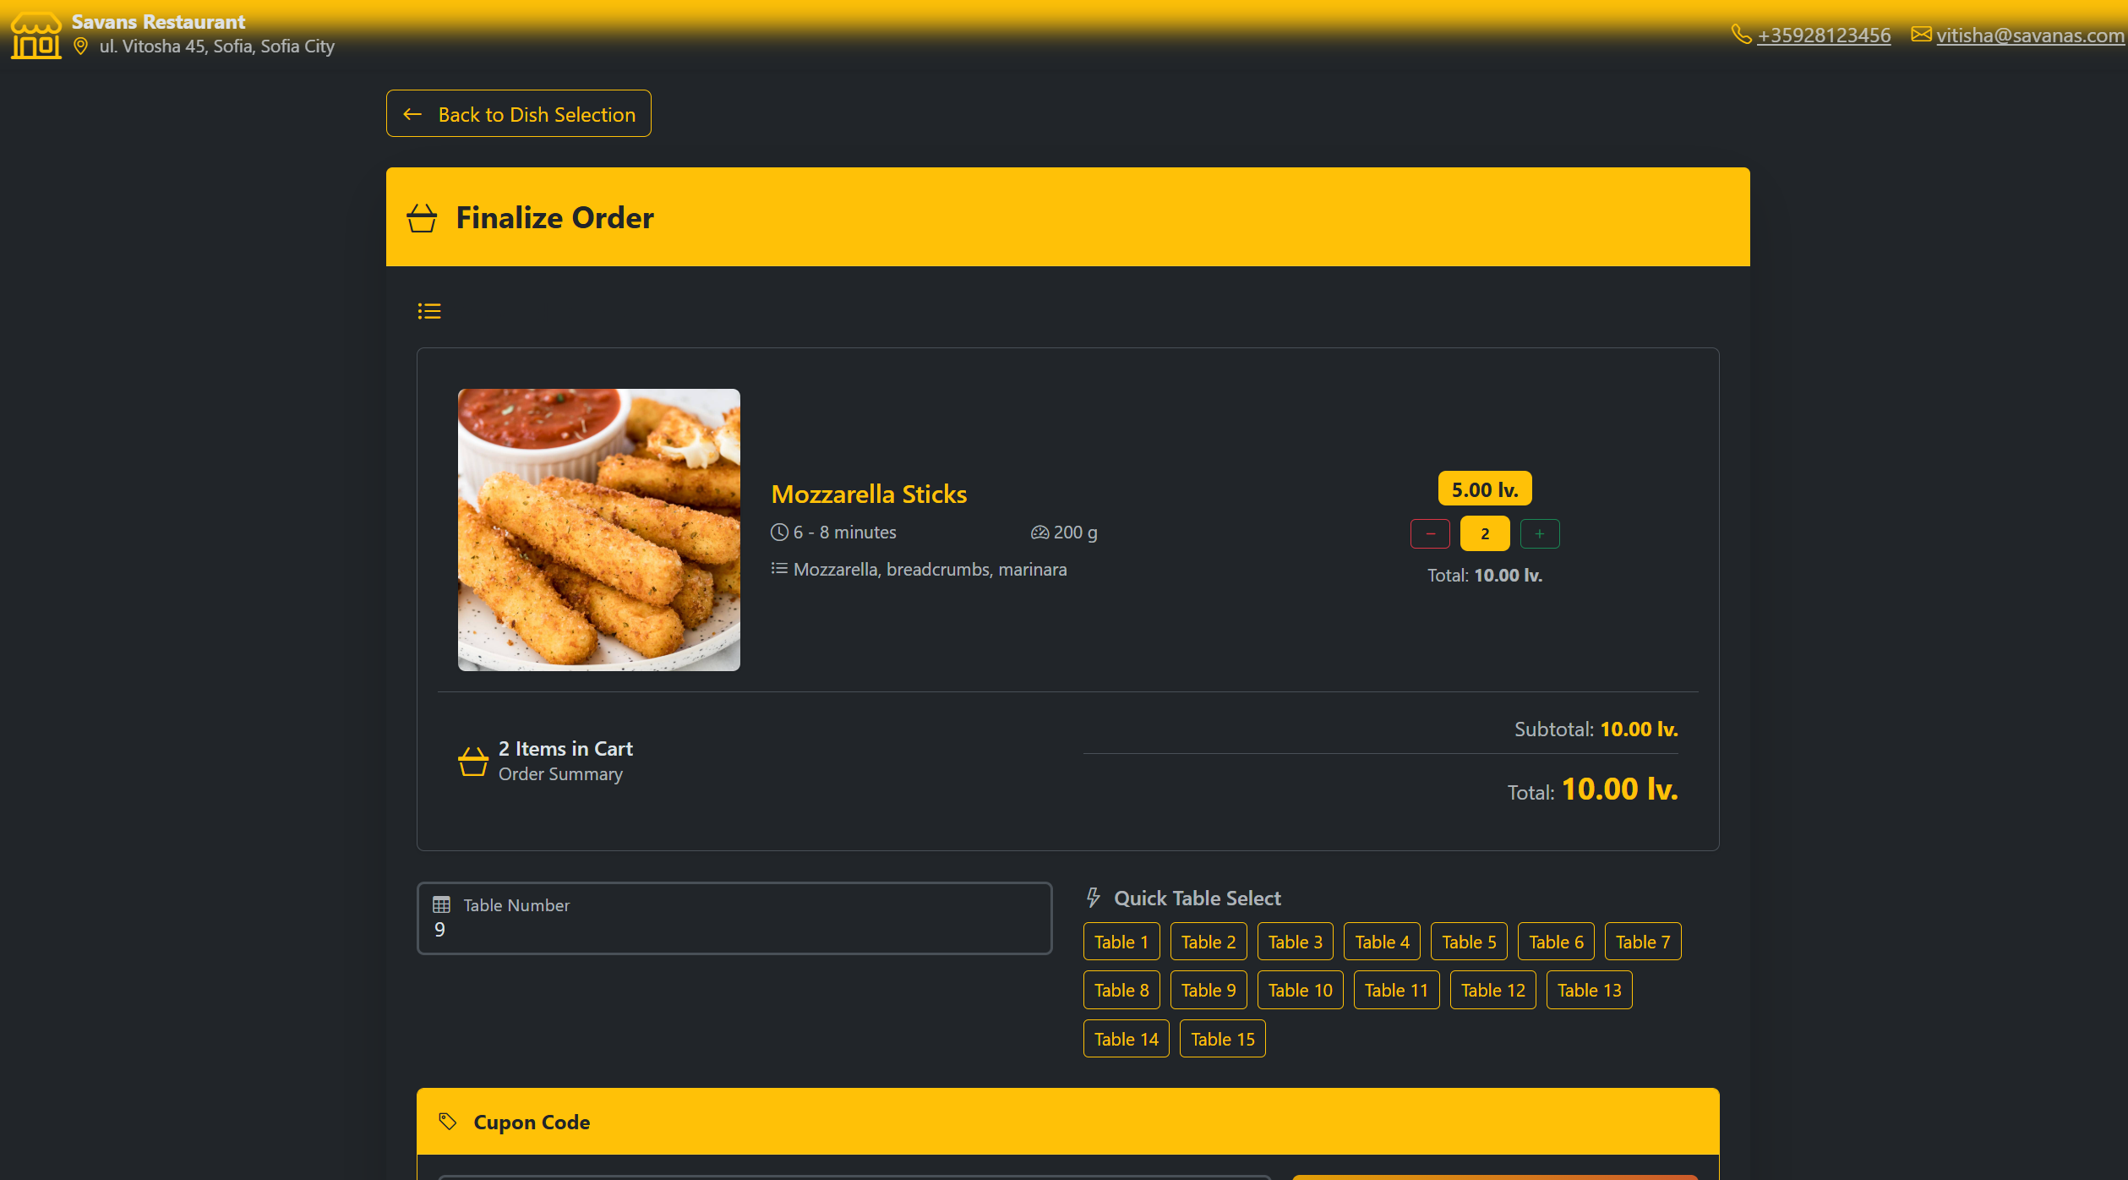
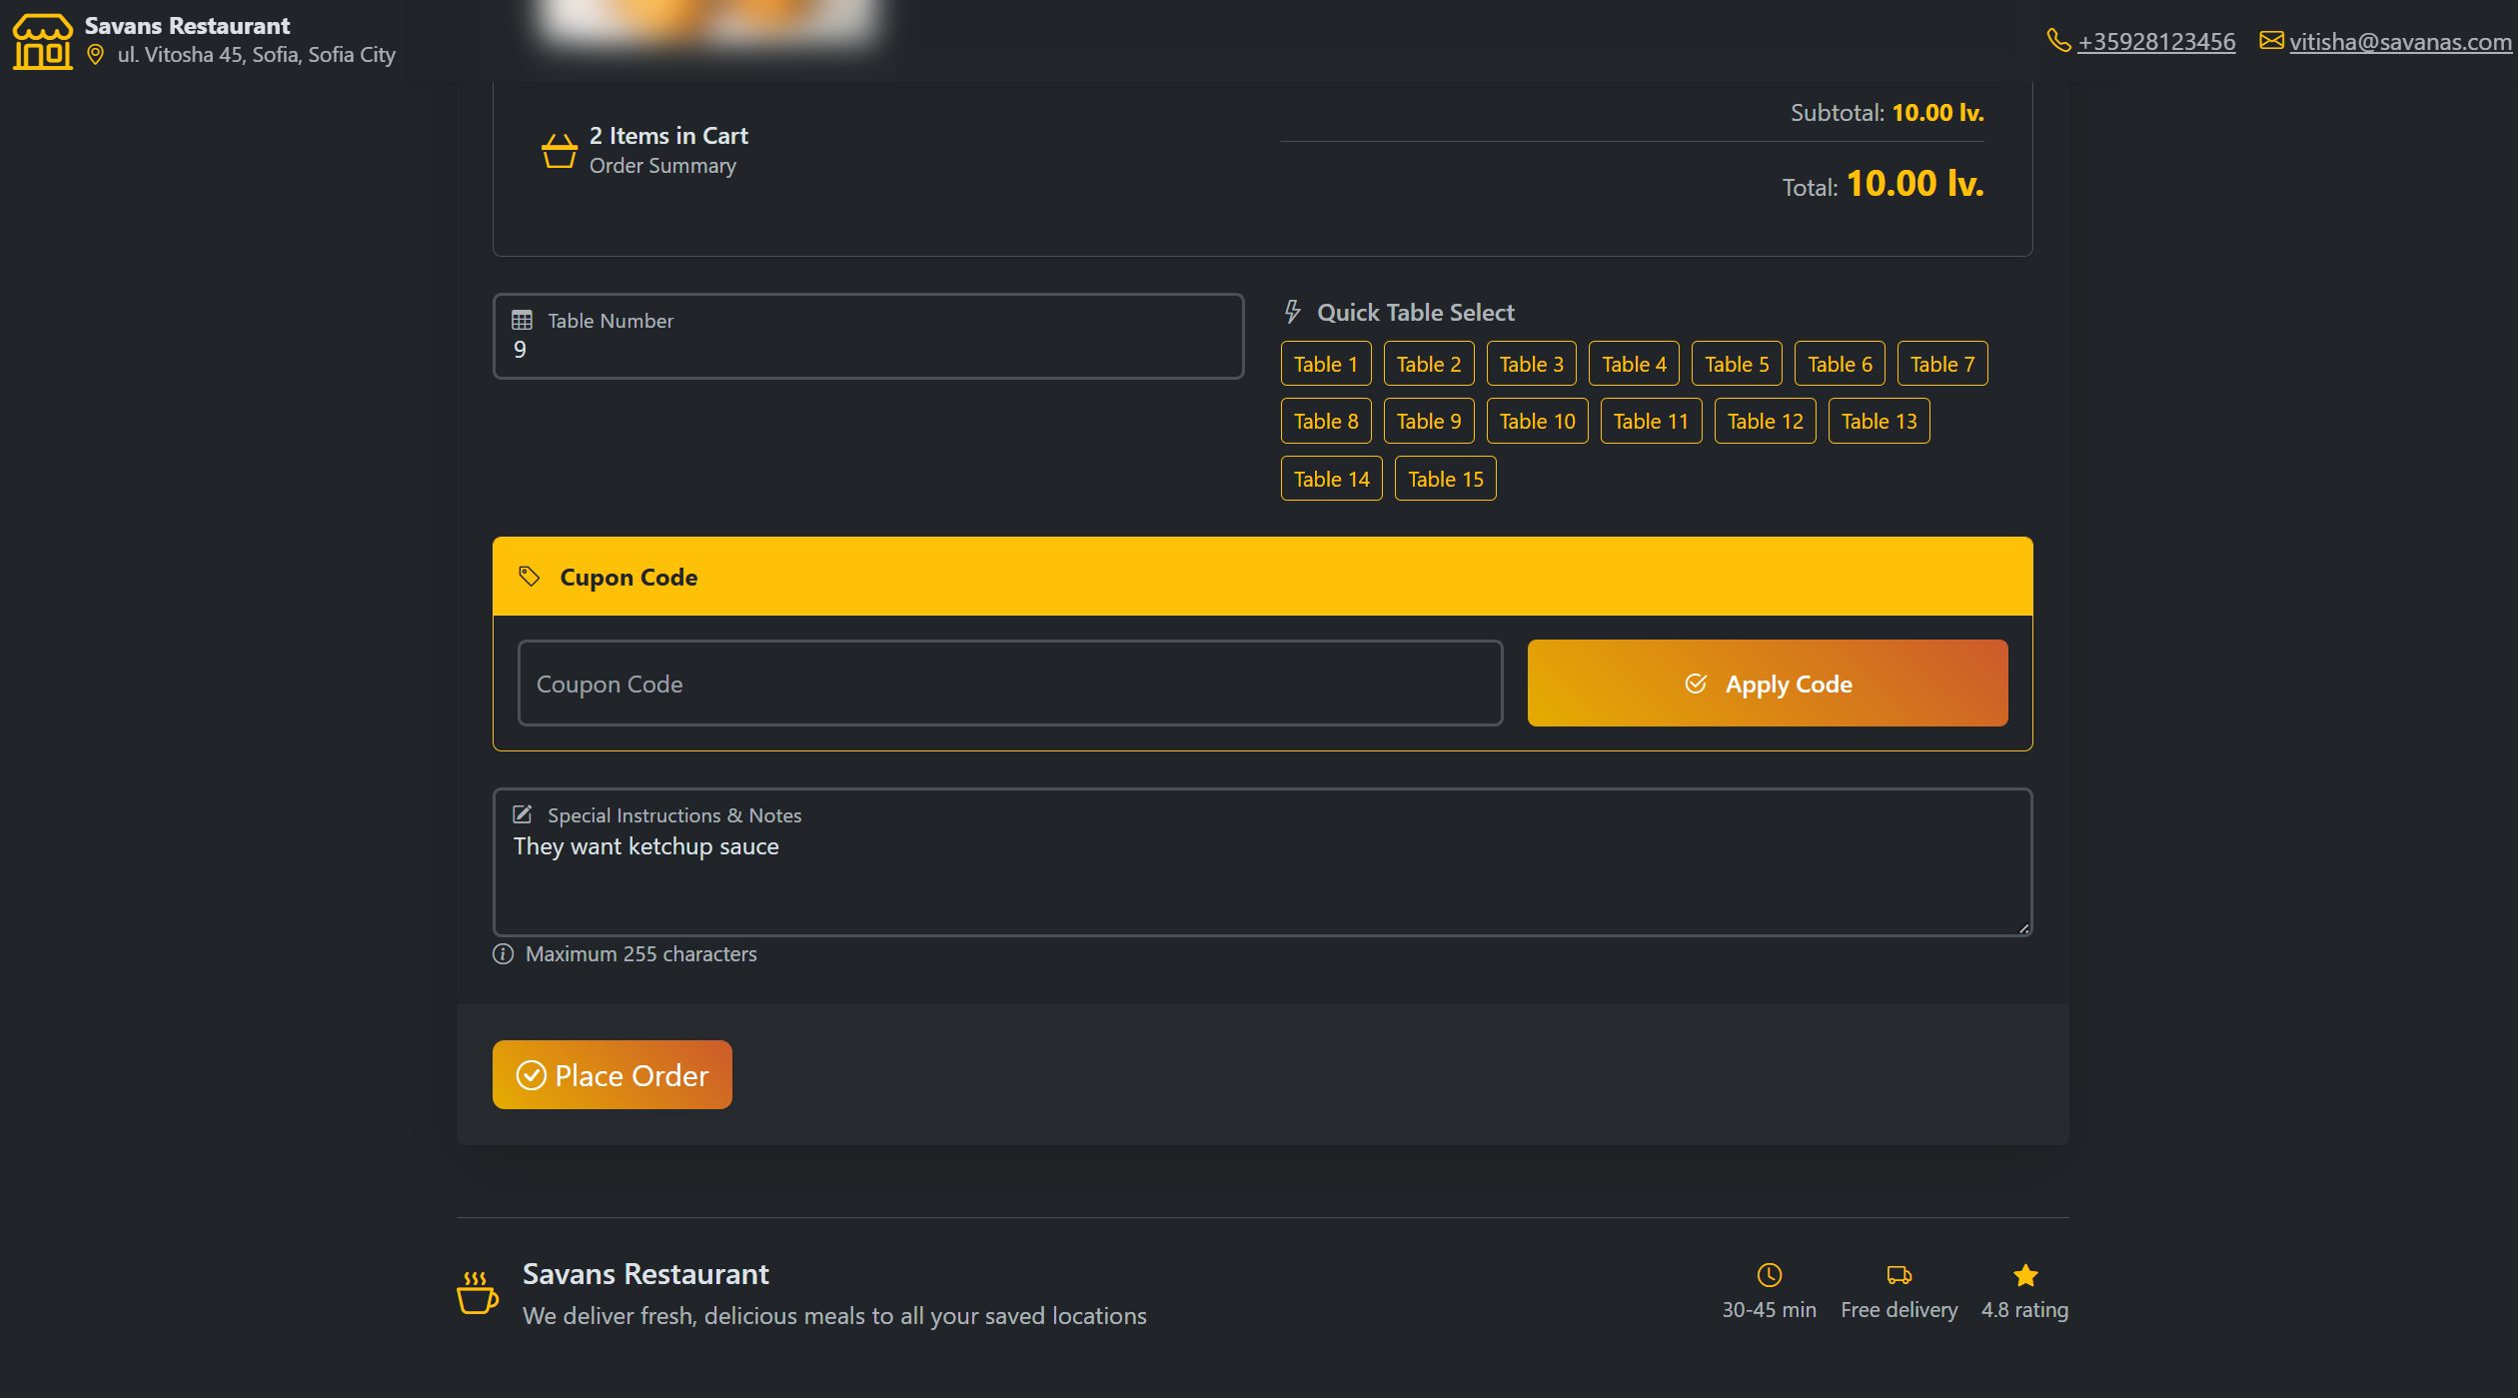
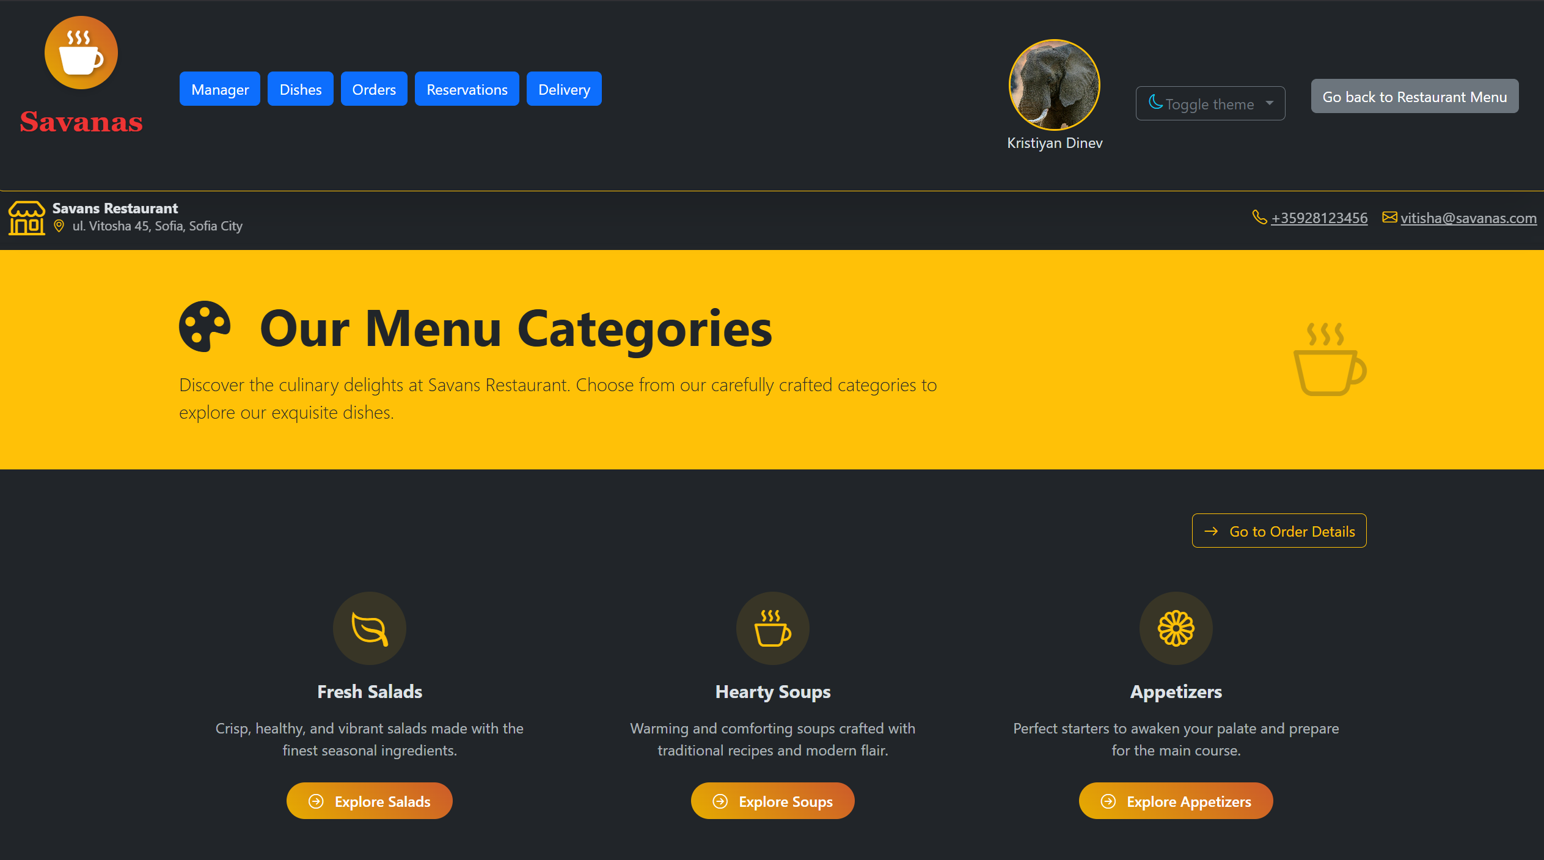
Admin panel – creating orders for customers
You can simply place an order for any customer who is dinning at the restaurant.
Simple, easy, fast

Slide 23
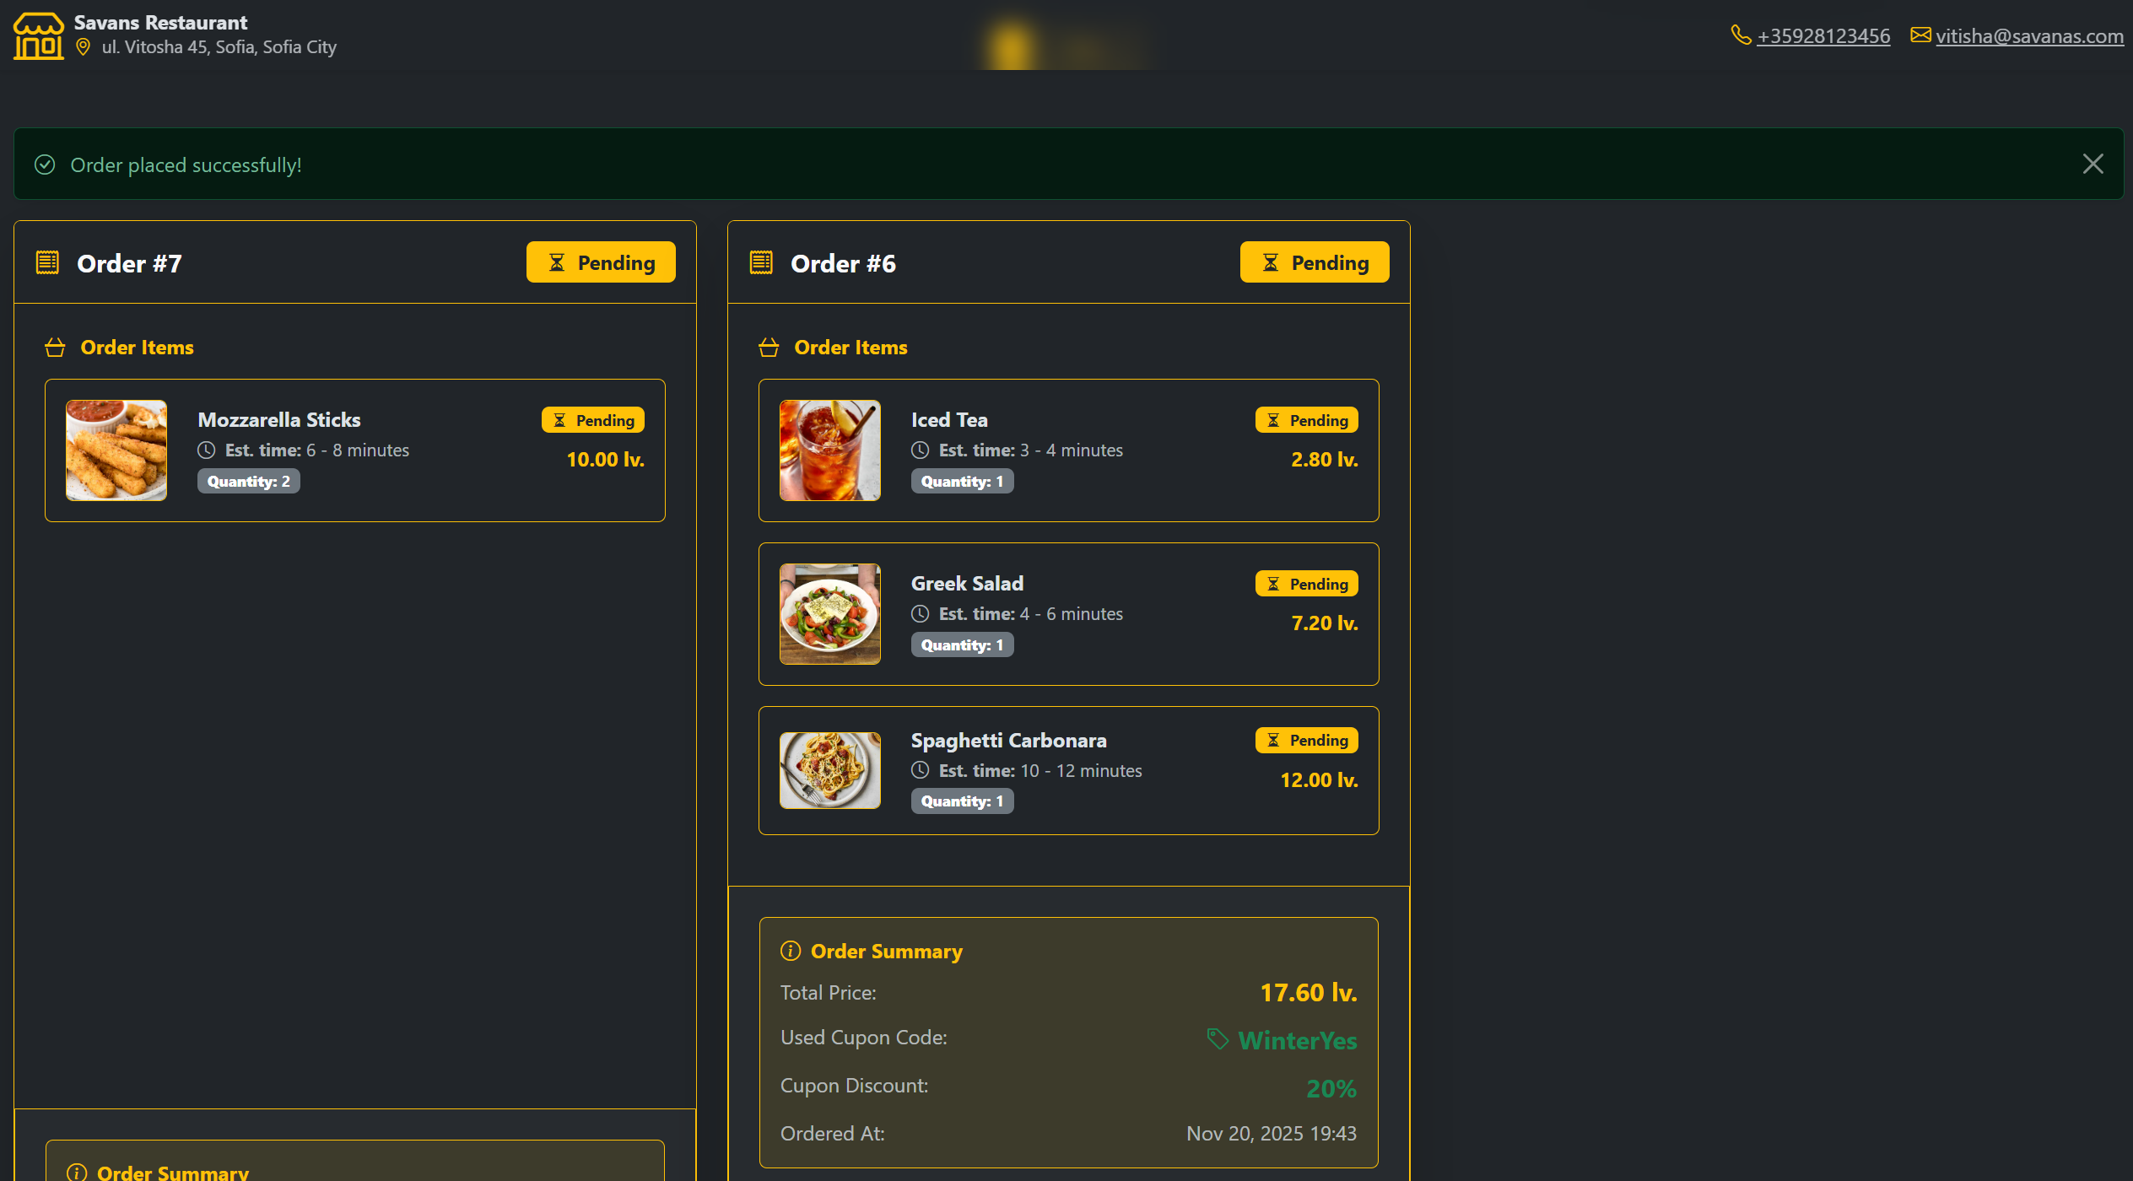
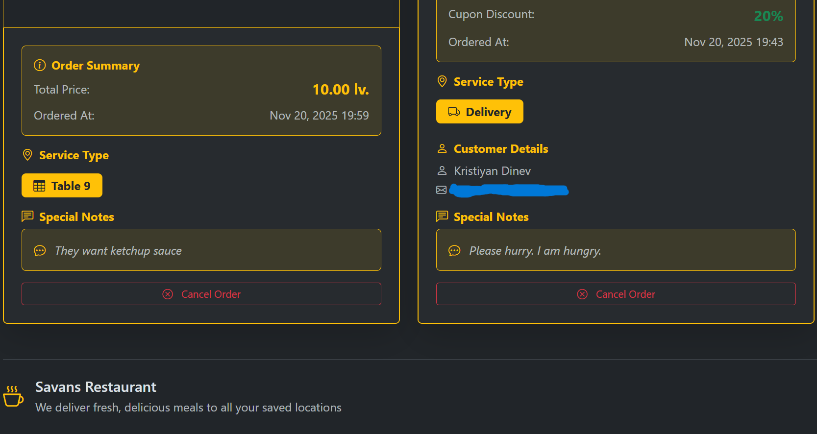
The two orders we have so far

Slide 24
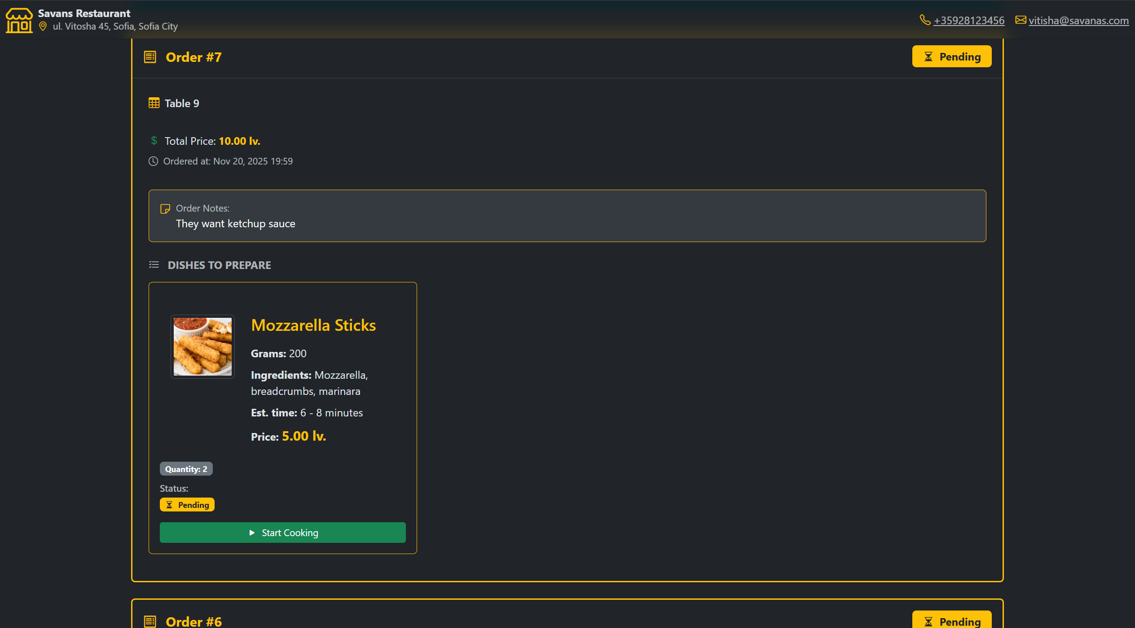
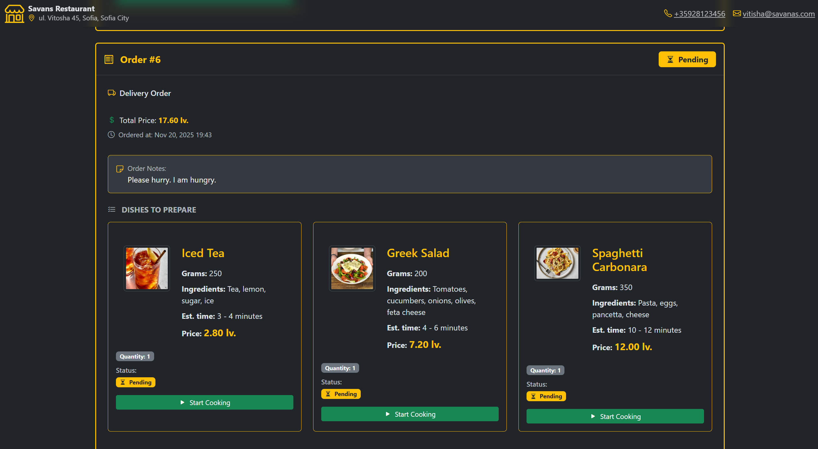
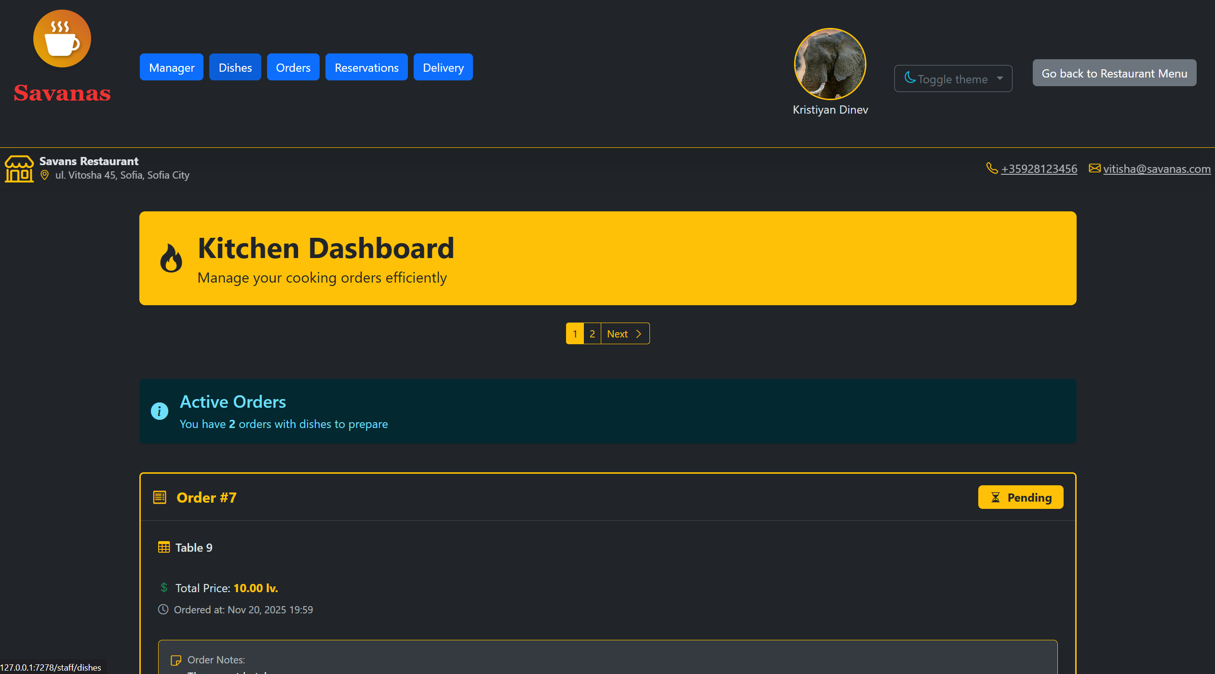
Admin panel - kitchen
Track and update the current status of the dish while cooking it in real time
Using WebSockets to deliver real time data to the client and server
Only staff with role Cook can access this page

Slide 25
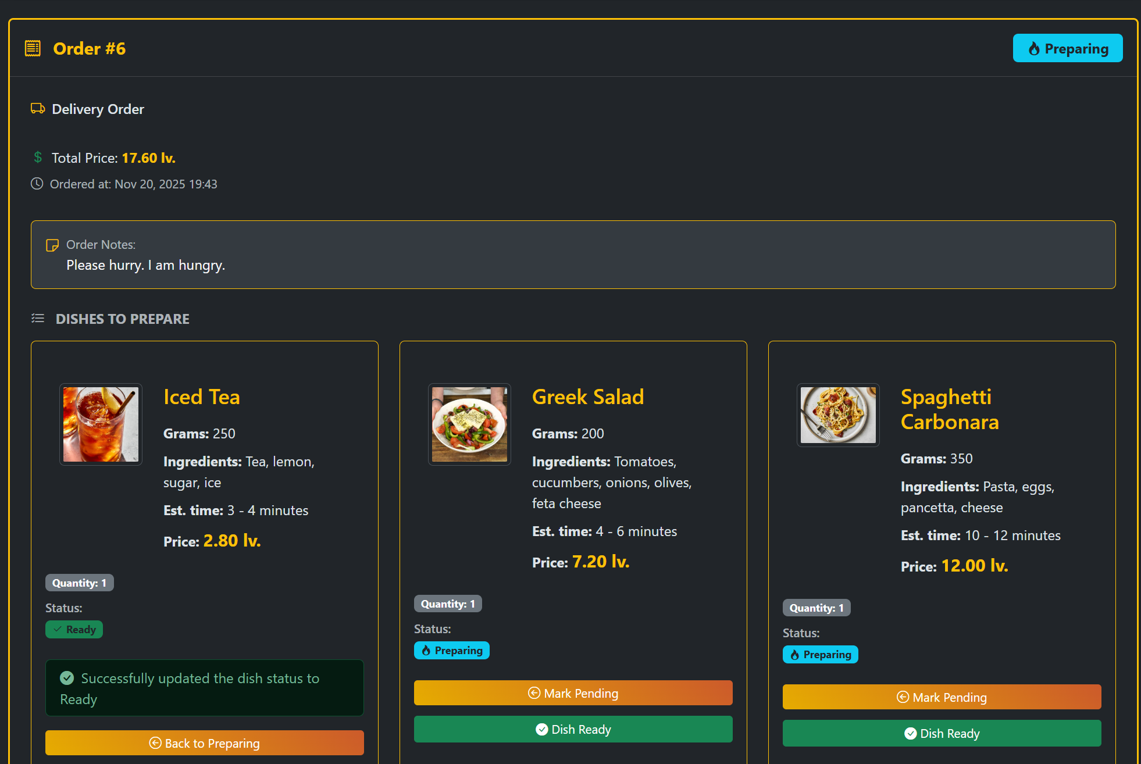
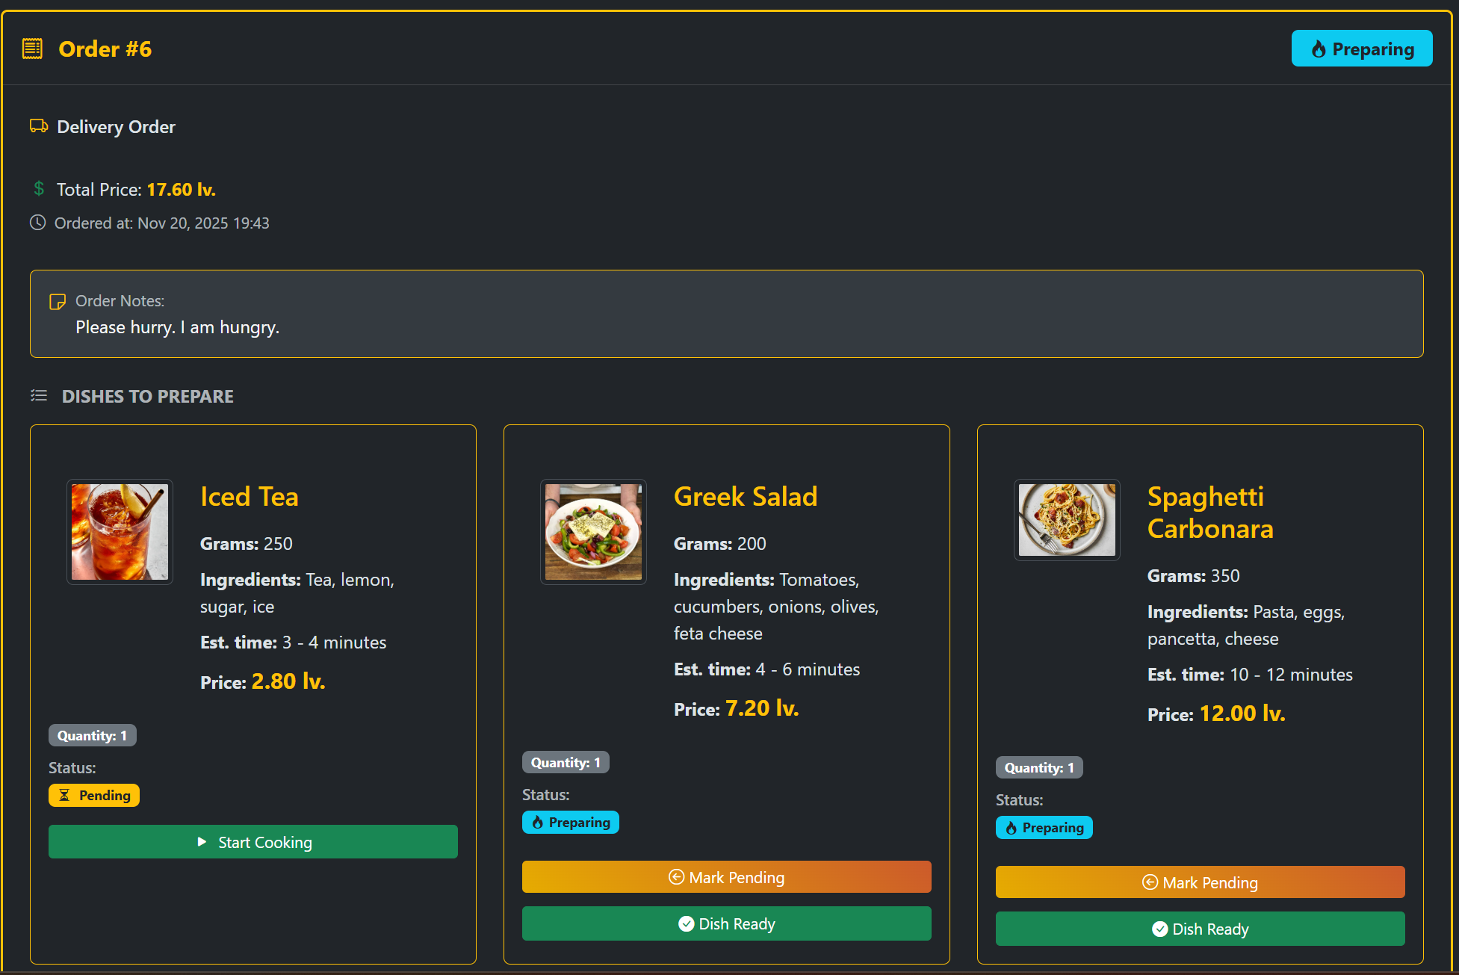
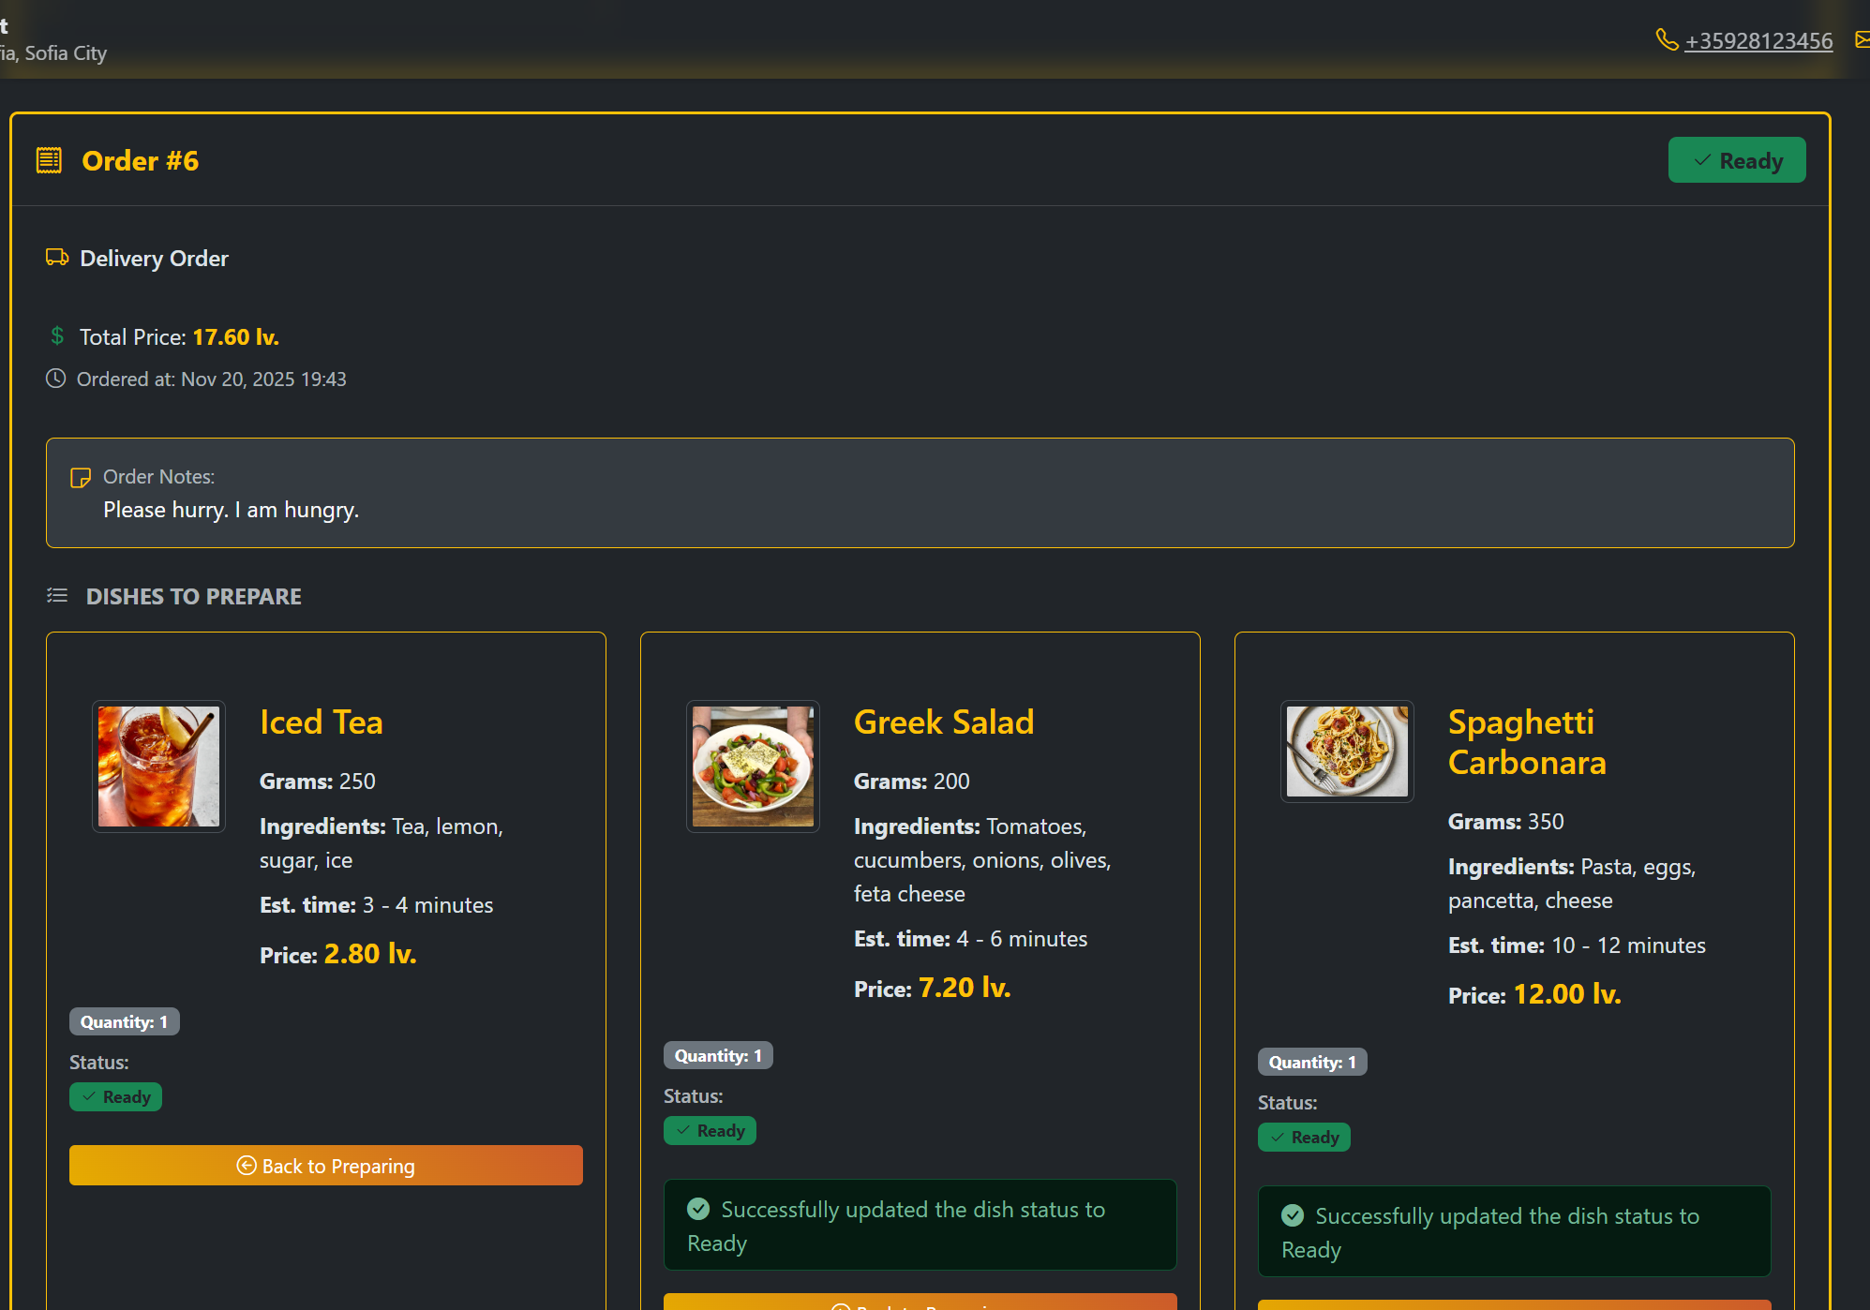
Real time data

Slide 26
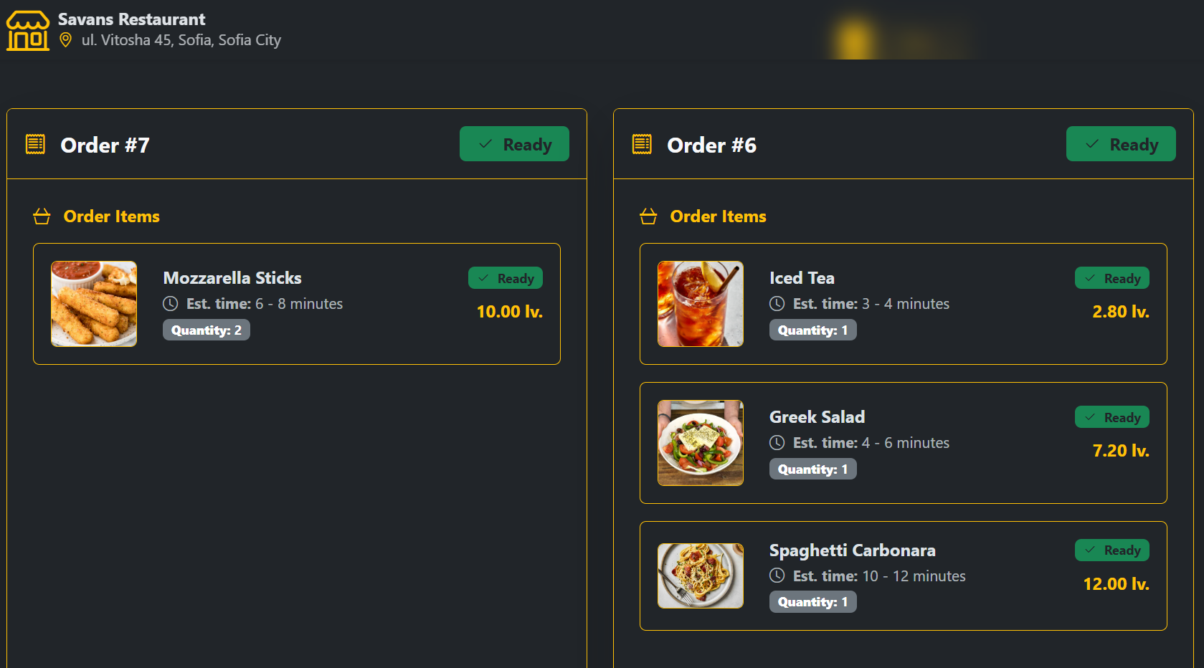
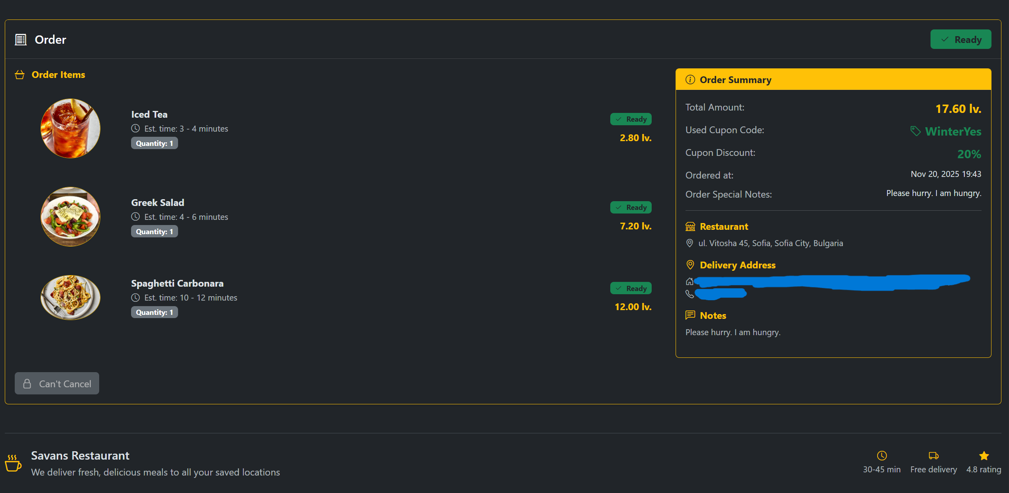
Back to the orders
We can now see that they have changed their status both on the admin’s side and customer’s side

Slide 27
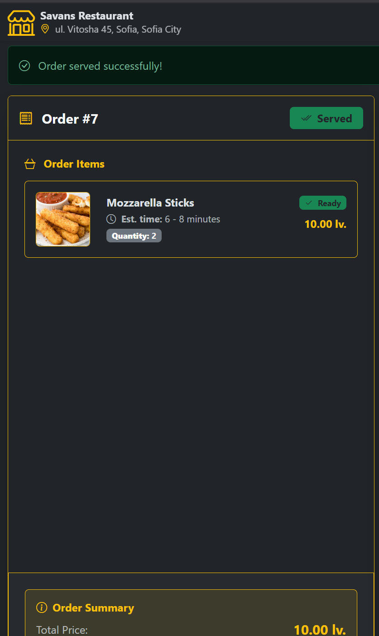
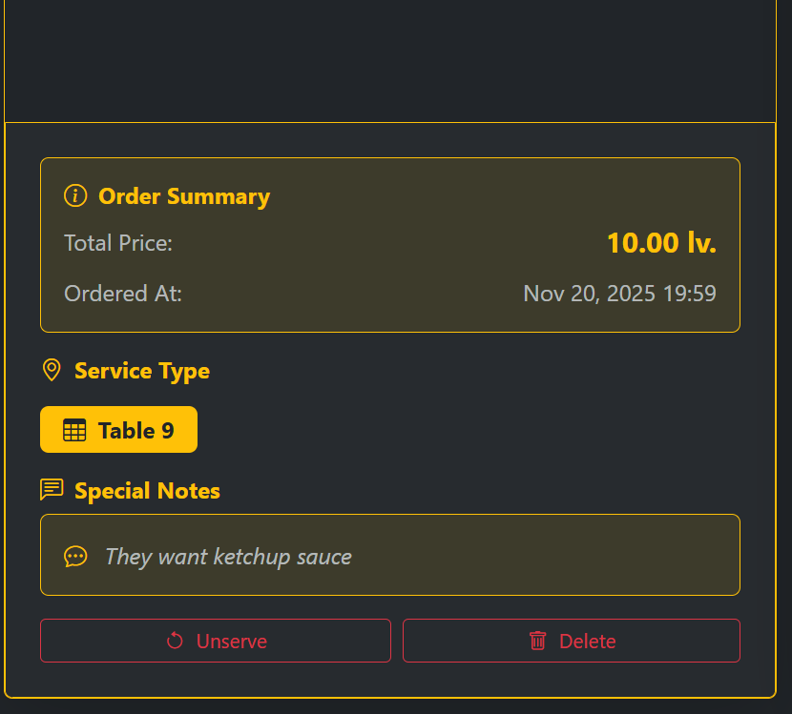
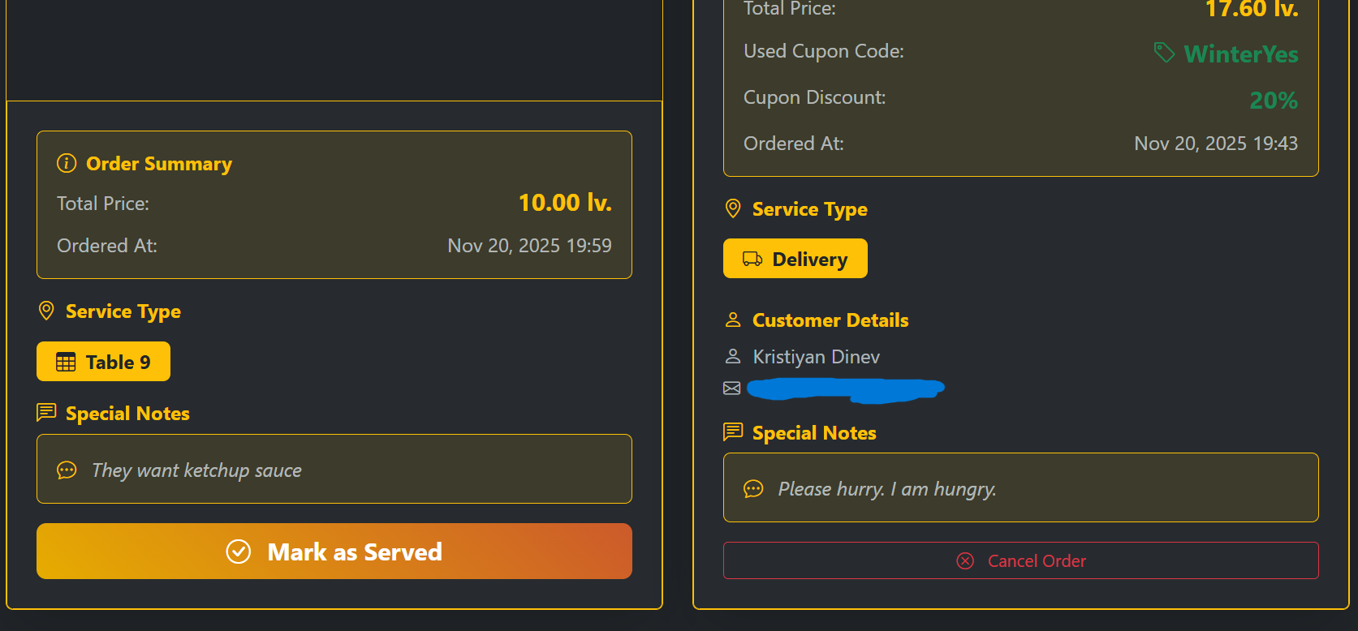
Marking one of the orders as surved

Slide 28
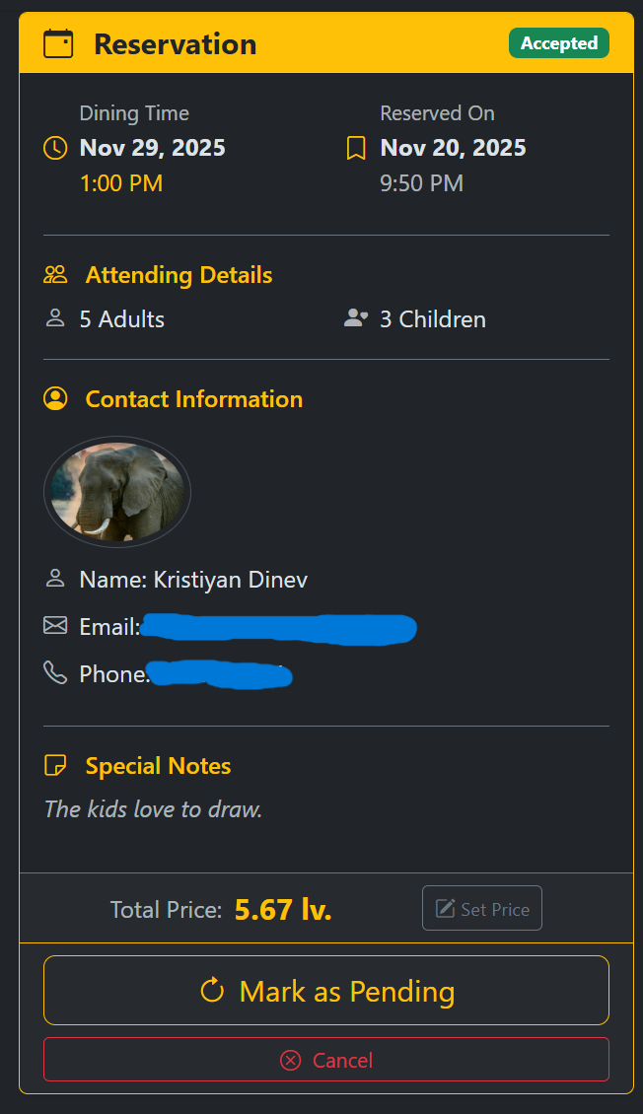
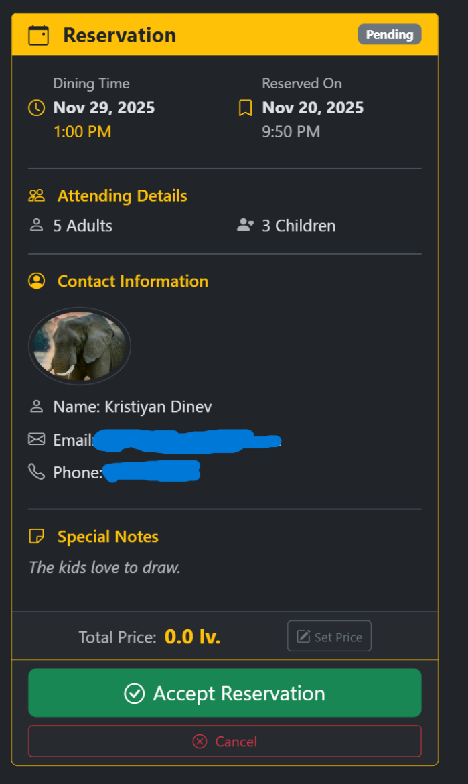
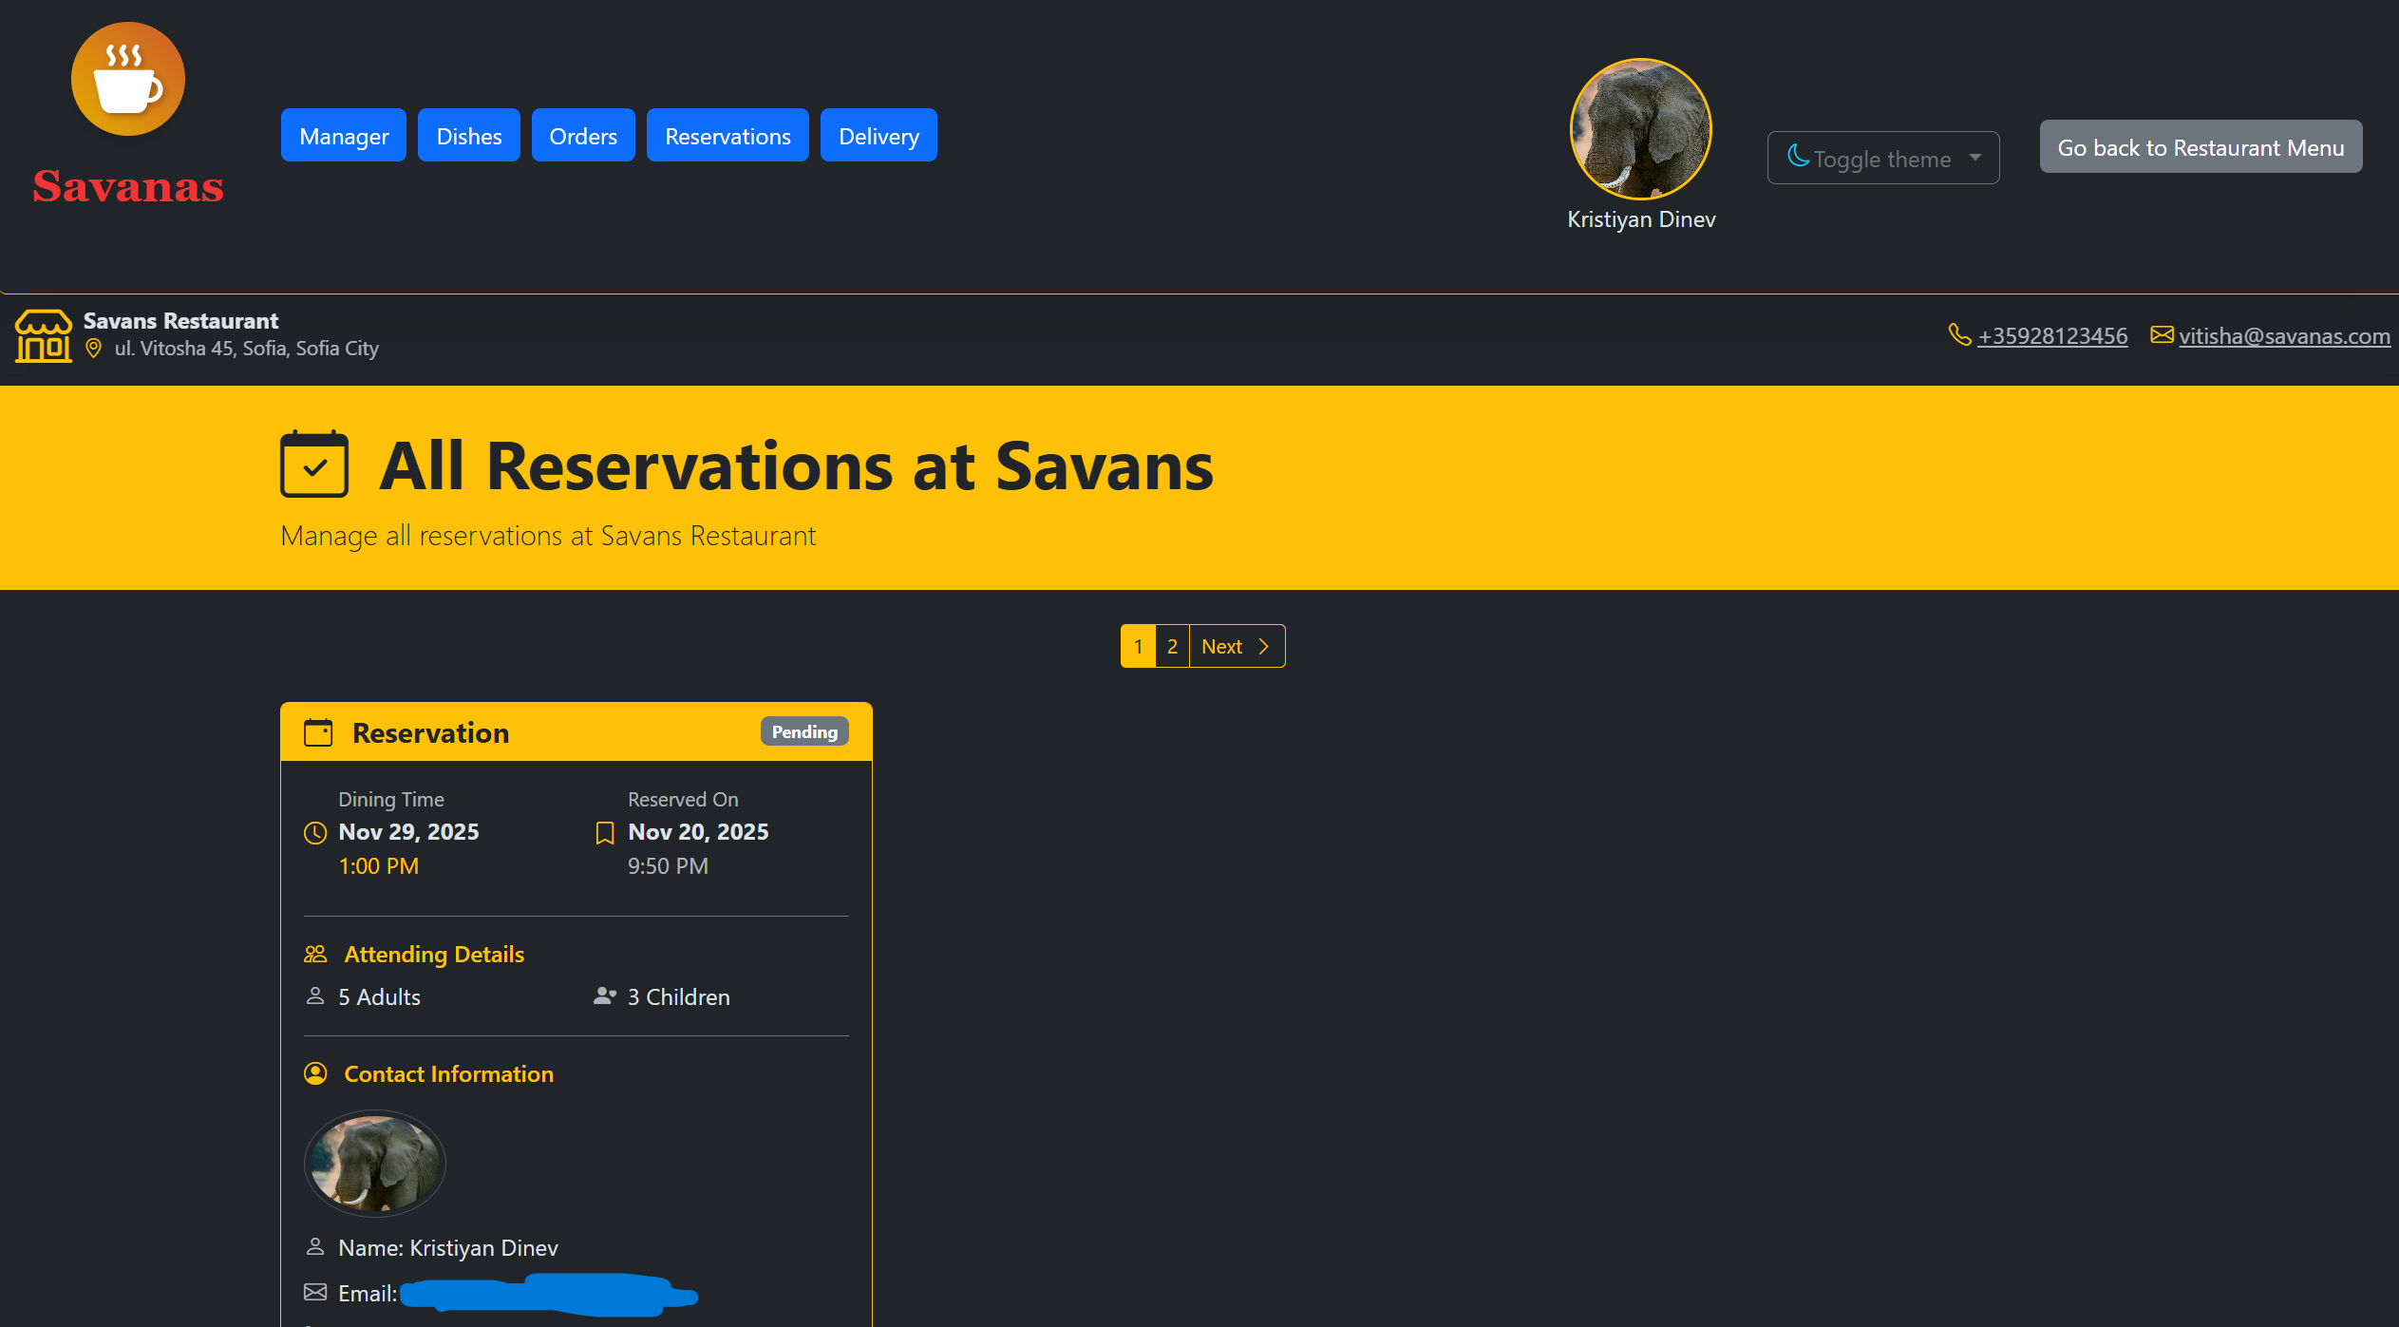
Admin panel - reservations
View, Update, Remove the restaurants reservations made by customers
Only staff with the role waiter/waitress can do this

Slide 29
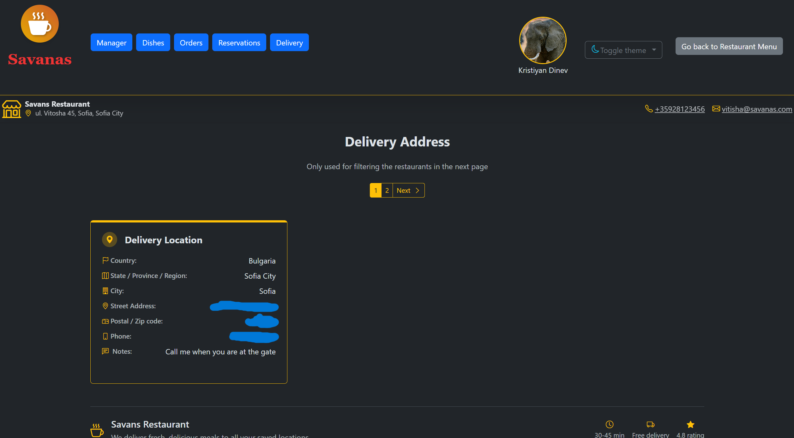
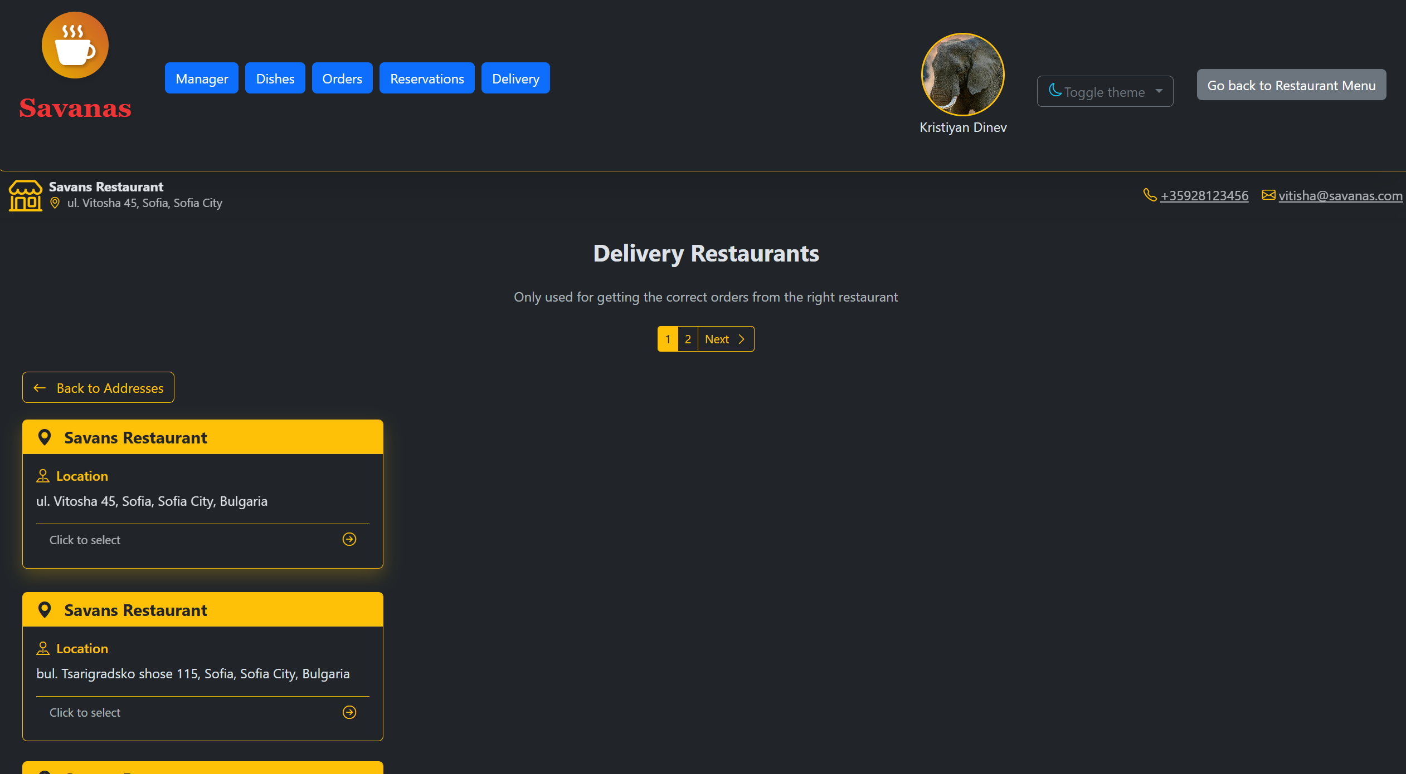

Admin panel - delivery
You can do deliveries only if you are staff with role delivery

Slide 30




Start your delivery order

Slide 31




Complete your delivery

Slide 32
Thank you for your attention!

